Slide 1
States of Matter
And their properties

Slide 2
Matter
Anything that has mass and occupies space

Slide 3
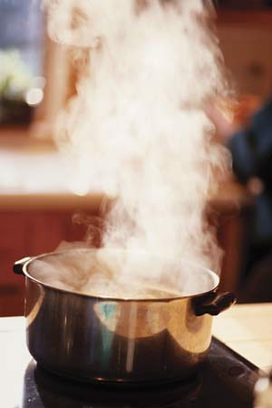
States of Matter
Solid
Liquid
Gas

Slide 4
Properties of Solids
Solids are a type of matter with a fixed shape and a fixed volume
Your pencil is a solid; its shape and volume will not change as you move it from place to place

Slide 5
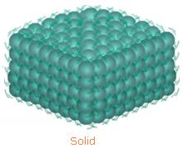
More properties of Solids
The particles of a solid are packed closely together
The particles of a solid cannot move from their spot
The particles in a solid vibrate back and forth in place

Slide 6
Properties of a liquid
Liquids have a fixed volume
Liquids take the shape of their container
If you pour a glass of water, it takes the shape of the glass

Slide 7
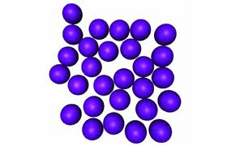
More Properties of liquids
The particles of a liquid are packed closely together
These particles can move from their spots

Slide 8
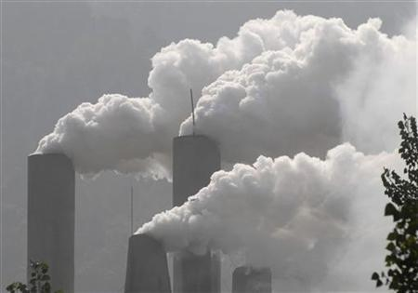
Properties of gases
A gas changes shape and volume.
Gas particles spread to fill up all the space available
Gases have neither definite shape nor volume. They take the shape and volume of their container.

Slide 9
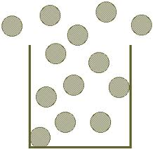
More Properties of Gases
Gas particles move around freely
Gas particles can spread out or be squeezed together

