Slide 1
Scientific Inquiry
Problem Solving in the Real World

Slide 2
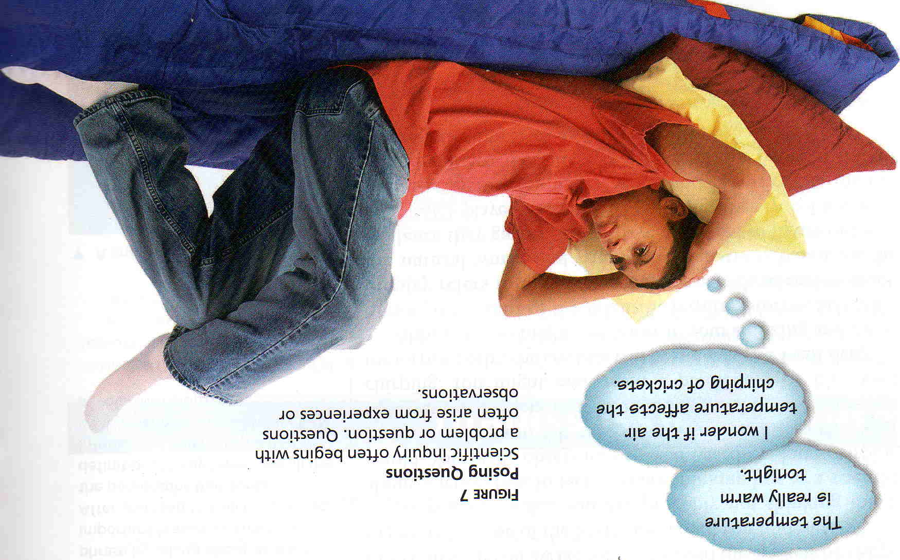
Problem or Observation
Scientific Inquiry often begins with a problem or question about an observation
“The temperature is really warm tonight.”
“I wonder if the air temperature affects the chirping of crickets?”

Slide 3
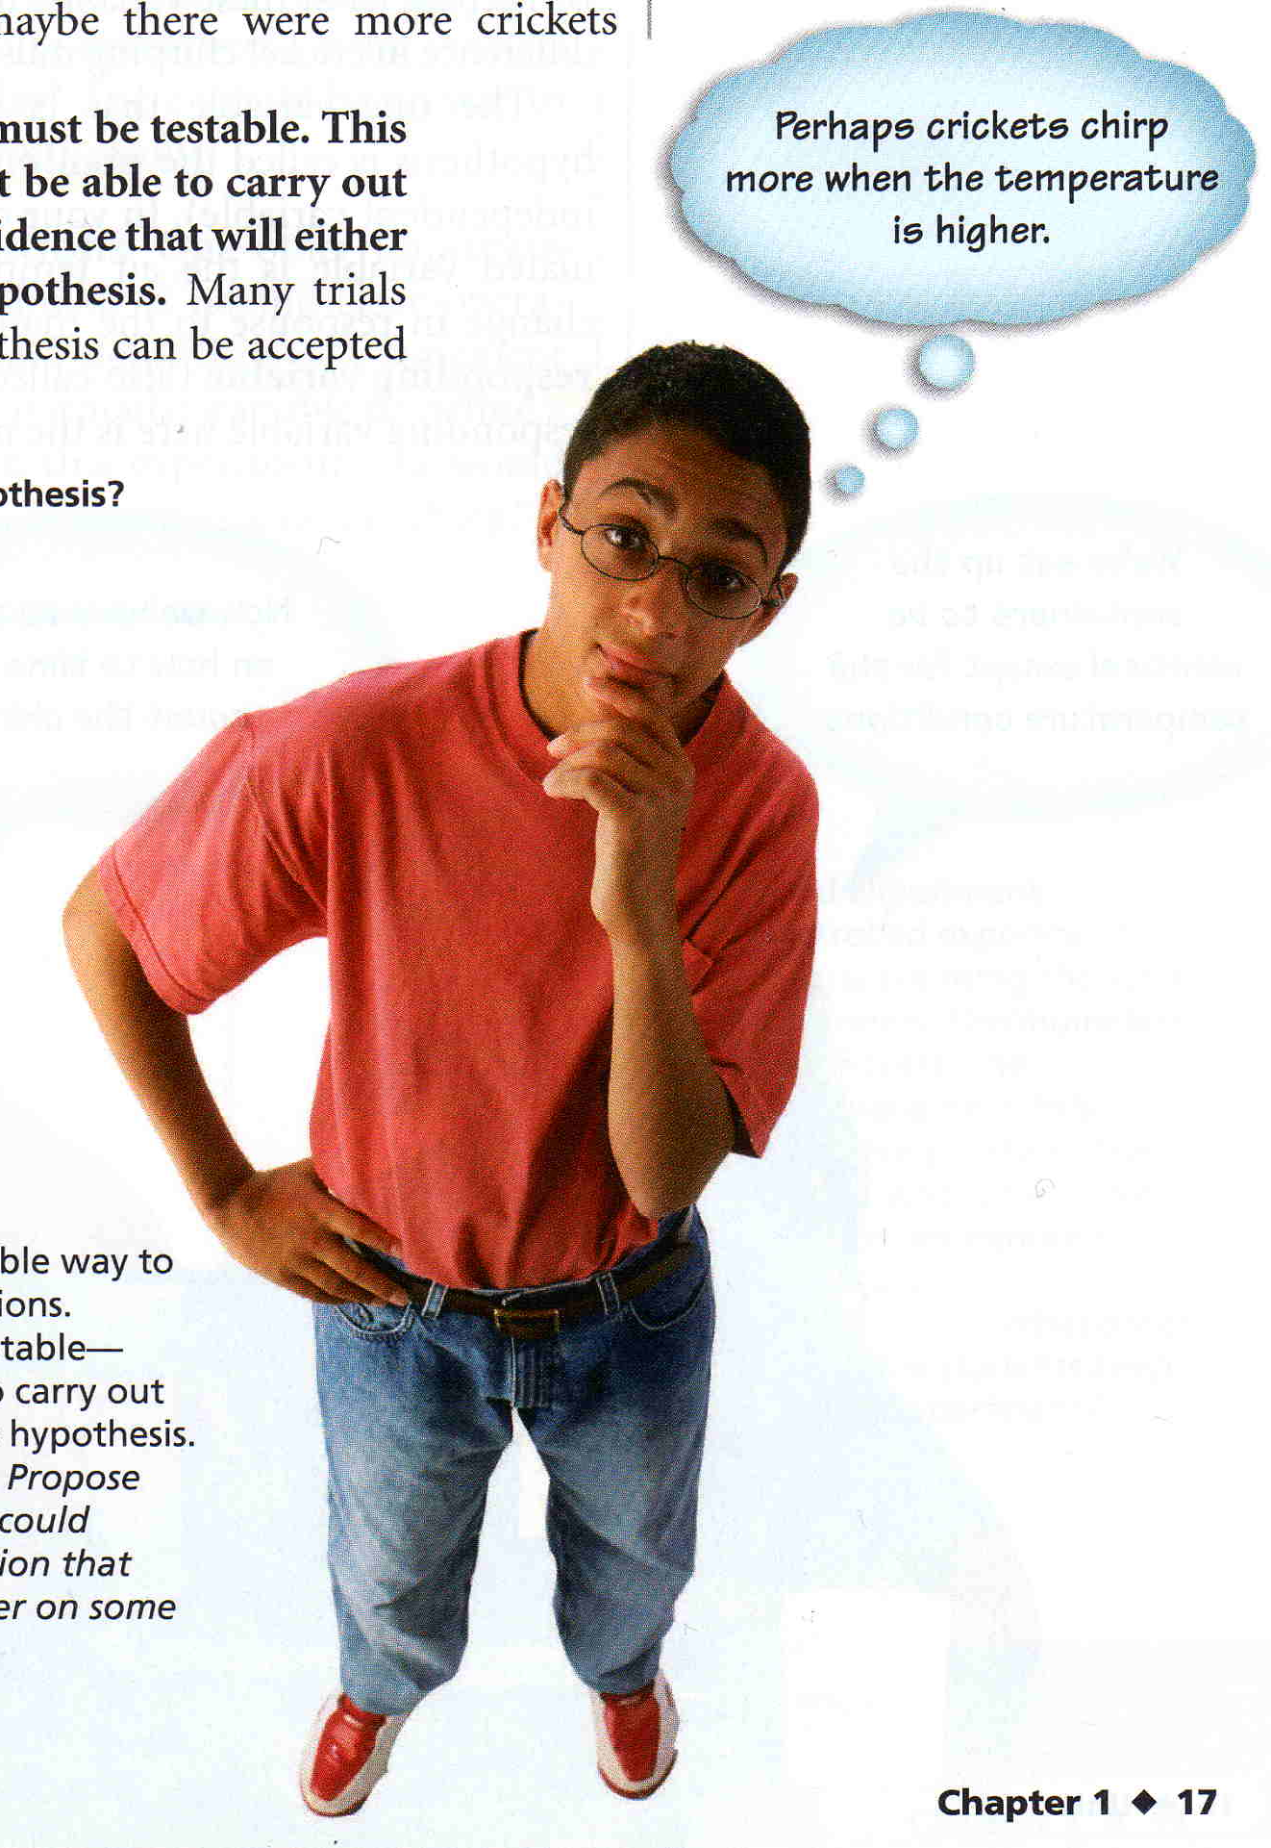
Developing a Hypothesis
A hypothesis is a possible explanation for a set of observations or an answer to a scientific question.
A hypothesis must be testable and research is usually done before a hypothesis is formed.
Hypothesis Formula: If-Then-Because
“If the temperature is higher outside then crickets will chirp more because they respond to hotter weather.”

Slide 4
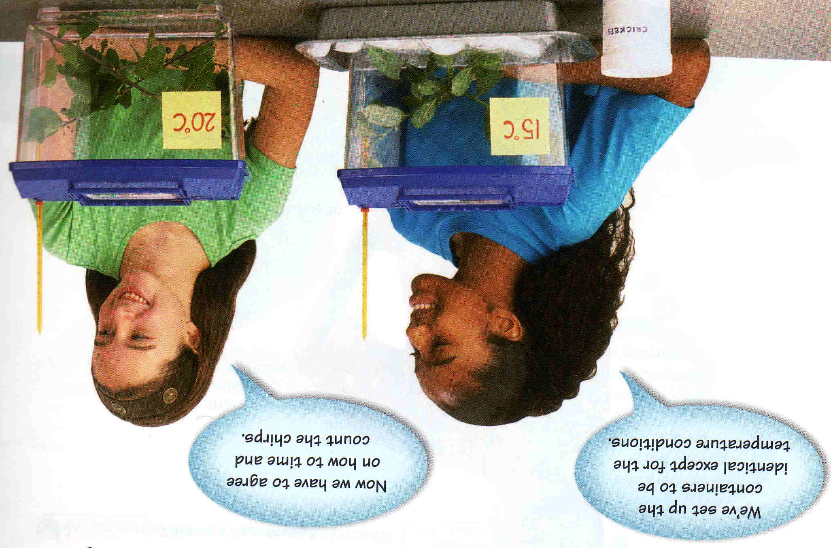
Designing an Experiment
After you state your hypothesis, you are ready to design an experiment to test it.

Slide 5
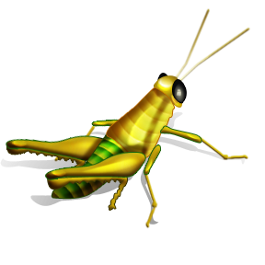
Designing an Experiment
Controlling Variables
To test your hypothesis you will need to observe crickets at different temperatures. All other variables need to remain exactly the same. Remember, a variable is any factor that can change in an experiment
What are some of the variables in this experiment?

Slide 6
Designing an Experiment
Controlling Variables
What is the manipulated (independent) variable in this experiment?
The manipulated (or independent) variable
is the one variable that you will change on purpose to test your hypothesis

Slide 7
Designing an Experiment
Controlling Variables
What is the responding (dependent) variable in this experiment?
The responding (or dependent) variable
is the one variable that changes because you changed the manipulated (independent) variable

Slide 8
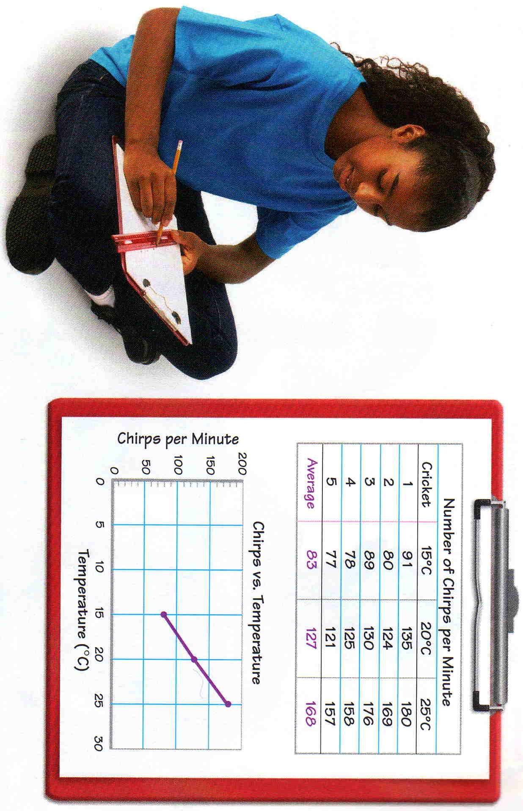
Collecting & Interpreting Data
Organizing your Data
Before you begin your experiment you should create a table to record your data. Remember that data are the facts, figures and other evidence gathered through observation

Slide 10
Collecting & Interpreting Data
Graphing Your Results
After all the data have been collected, they need to be interpreted. A graph is a useful tool for interpreting data.

Slide 11
Collecting & Interpreting Data
Graphing Your Results

Slide 12
Analysis
Now that that you have gathered and interpreted your data, you must determine if the data supports or rejects your hypothesis

Slide 13
Drawing Conclusions
After you have your analysis, you can draw conclusions about your hypothesis.
A conclusion is a summary of what you have learned about your hypothesis.

Slide 14
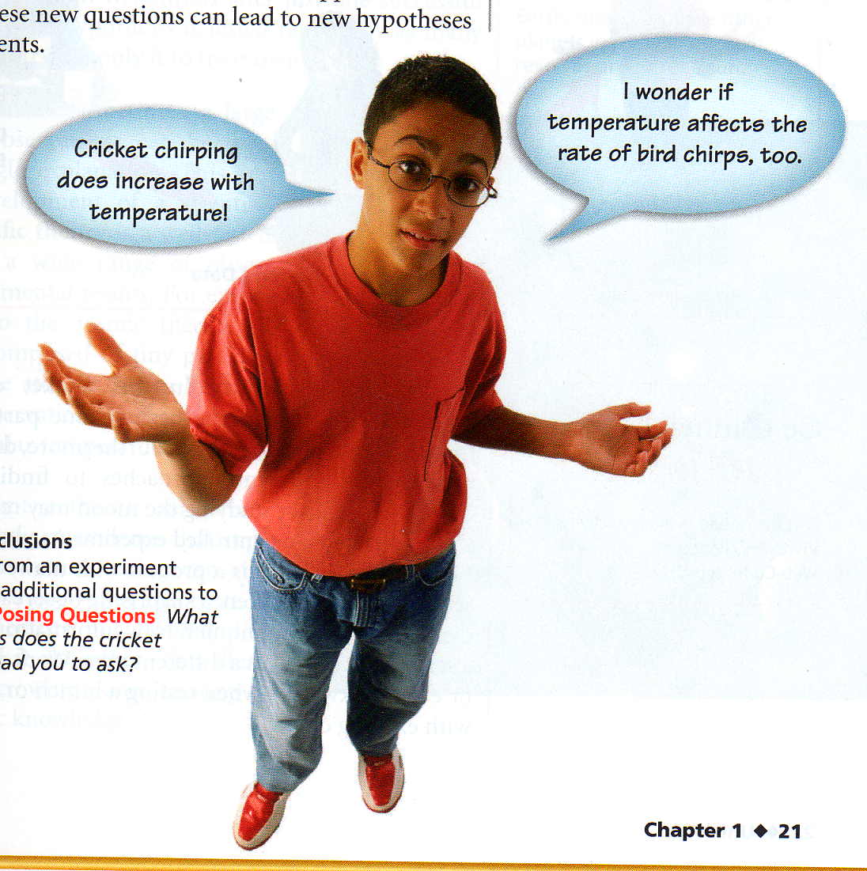
Drawing Conclusions
Inquiry Leads to Inquiry
Scientific inquiry usually doesn’t end once a set of experiments is done. Often, one scientific inquiry leads to another one.
“Cricket chirping does increase with temperature!”
“I wonder if temperature affects the rate of bird chirps too?”

Slide 15
The Nature of Inquiry
In this cricket experiment, you decided to test your hypothesis in one particular way. Your friend may do it another way.
Different questions may require different approaches to finding answers

Slide 16
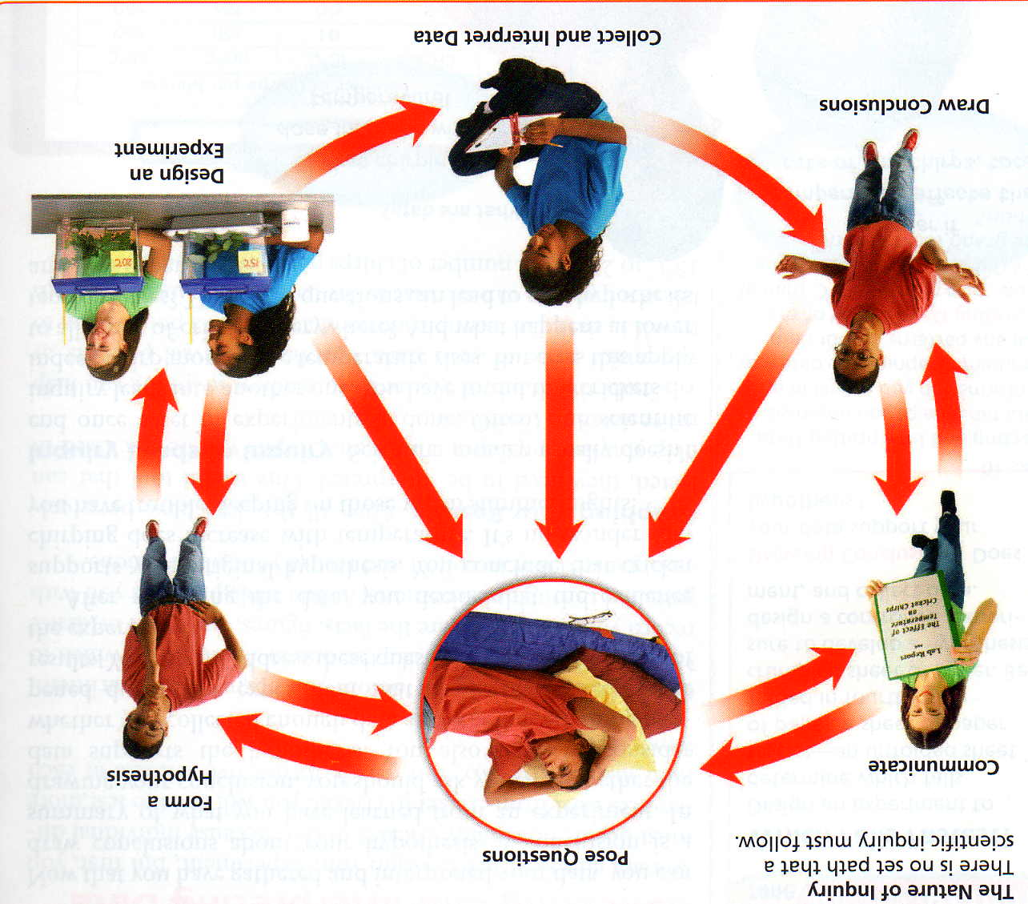
The Nature of Inquiry
Scientific inquiry is a process with many paths, not a rigid sequence of steps. Work may go forward—or even backward—when testing a hunch or fitting new ideas into existing ones

