Slide 1
Measurement
A Common Language

Slide 2
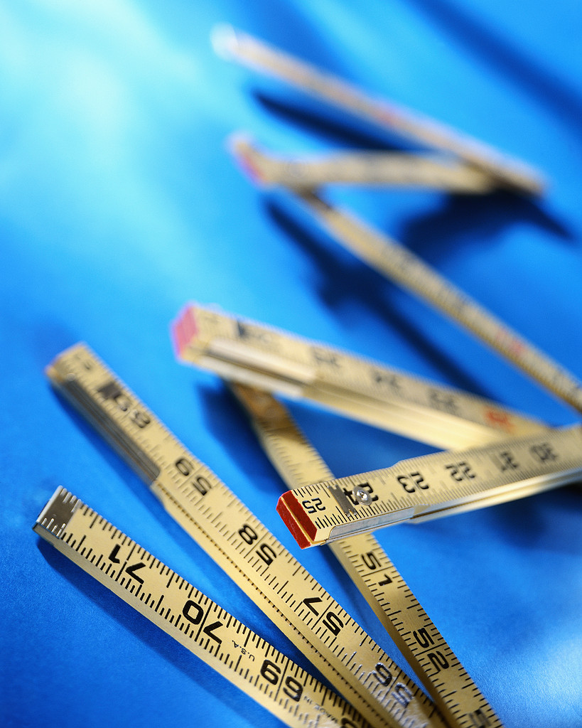
A Standard Measurement System
The Metric System
More than 200 years ago, most countries used their own measurement systems.
In the 1790’s French scientists created the Metric System—a measurement system based on the number 10.

Slide 3
A Standard Measurement System
The International System of Units
The modern version of the metric system
Abbreviated SI
Measures: Length, Mass, Volume, Density, Time and Temperature
Using SI allows scientists from all over the world to compare data and communicate about their results

Slide 4
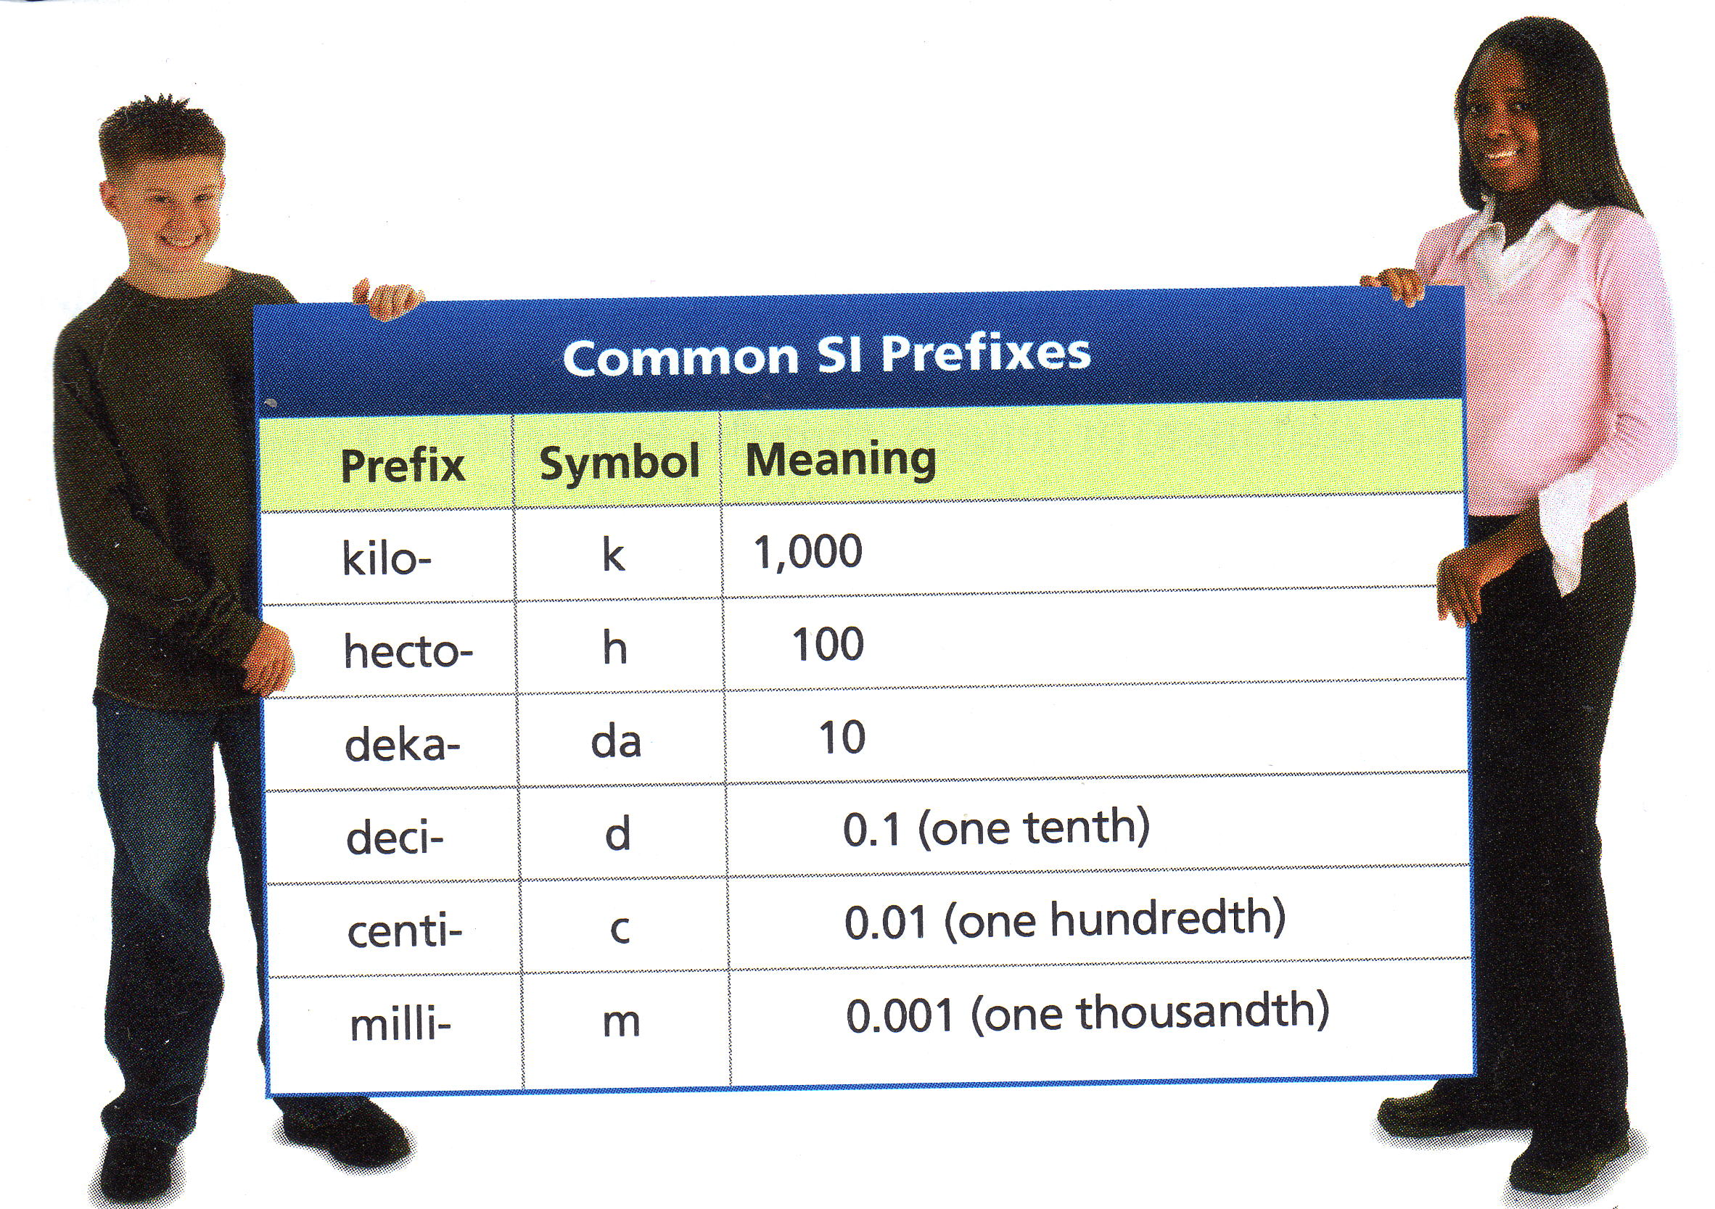
SI units based on multiples of 10 are easy to use. Knowing what the prefixes mean can help you judge how big or small a measurement is.

Slide 5
Length
In The Metric System

Slide 6
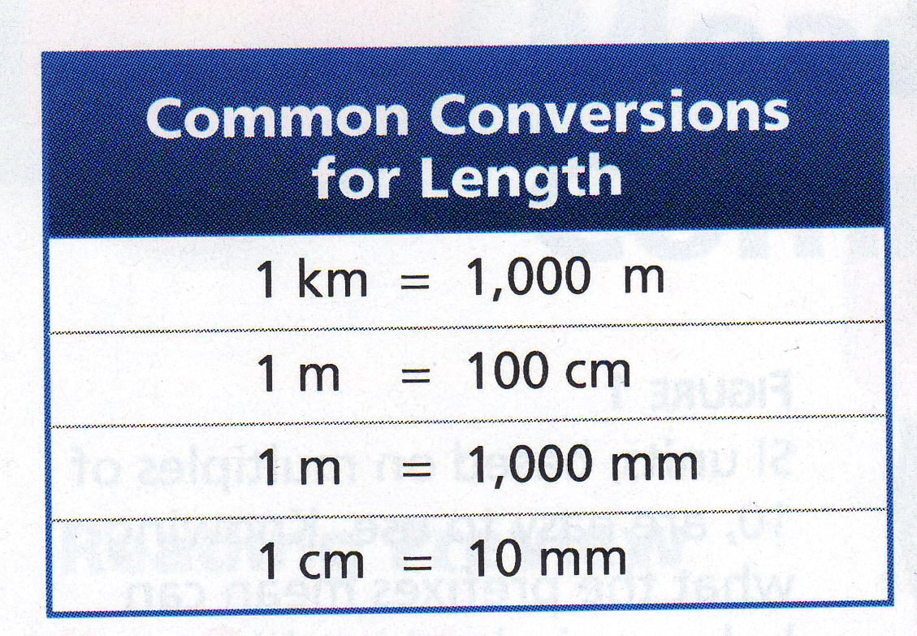
Length
The basic unit of length in the Metric (SI) system is the METER (m)
One meter is about the distance from the floor to a door knob
centiMETER
milliMETER
kiloMETER

Slide 7
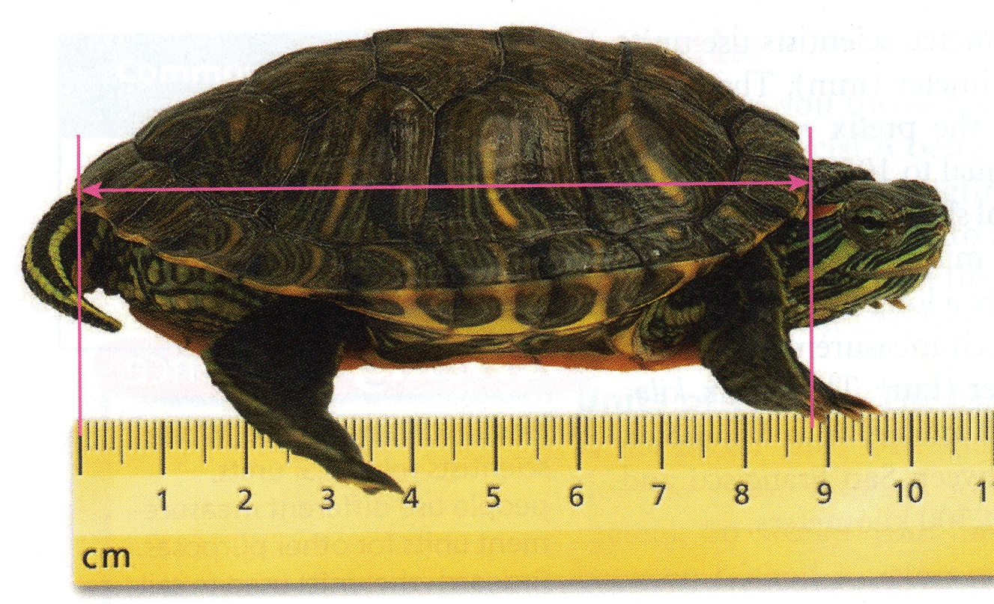
Measuring Length
Metric Ruler
Meter Stick

Slide 8
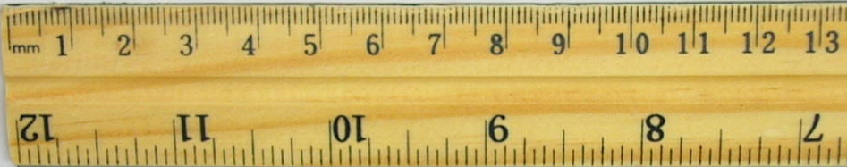
Metric (SI)
1cm
1cm
1cm
1inch
English

Slide 9
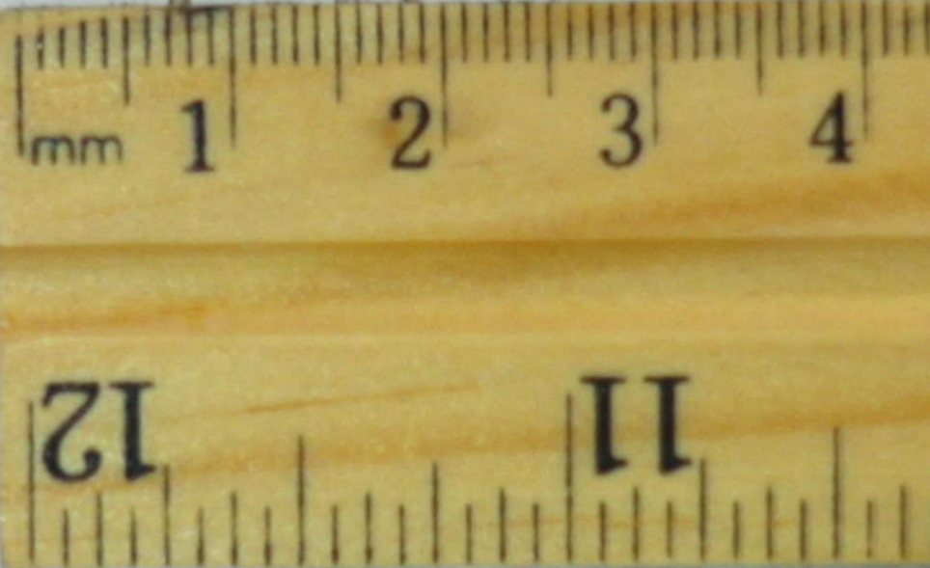
Metric (SI)
1/10th of a centimeter
1 millimeter
1/16th of an inch
English

Slide 10
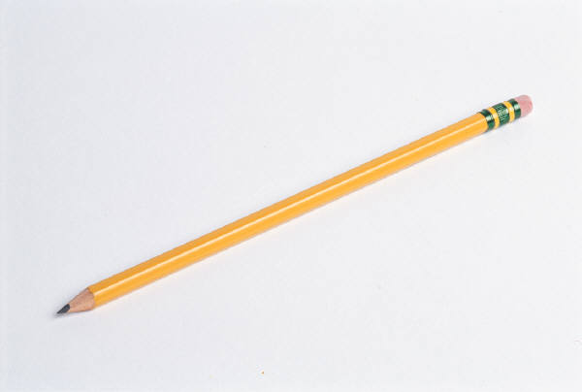
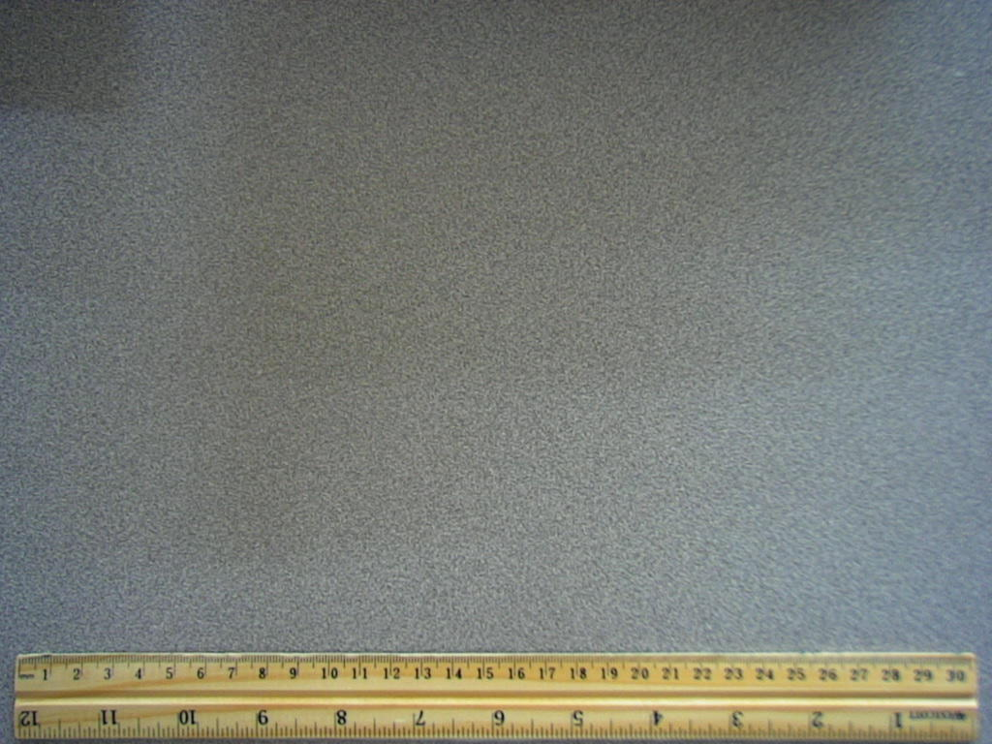
How long?

Slide 11
How long?
Make sure the object is lined up with the first line NOT the end of the ruler

Slide 12
How long?
Look at the end of the pencil. What is the closest centimeter number to the end of the object that is SHORTER than the object?
16 centimeters
Count the number of millimeters between 16 and the end of the pencil
6 millimeters

Slide 13
How long?
16 centimeters and 6 millimeters
16.6 centimeters

Slide 14
Volume
In The Metric System

Slide 15
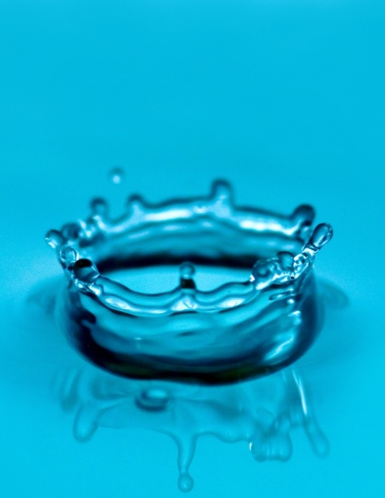
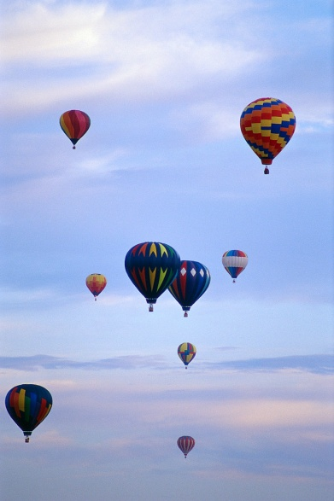
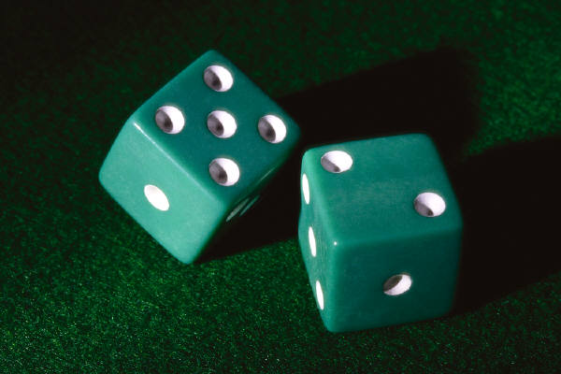
Volume
The amount of space an object takes up
The basic unit of Volume in the Metric (SI) system is the LITER (L)
Everything has a volume
  Solids
  Liquids
  gases

Slide 16
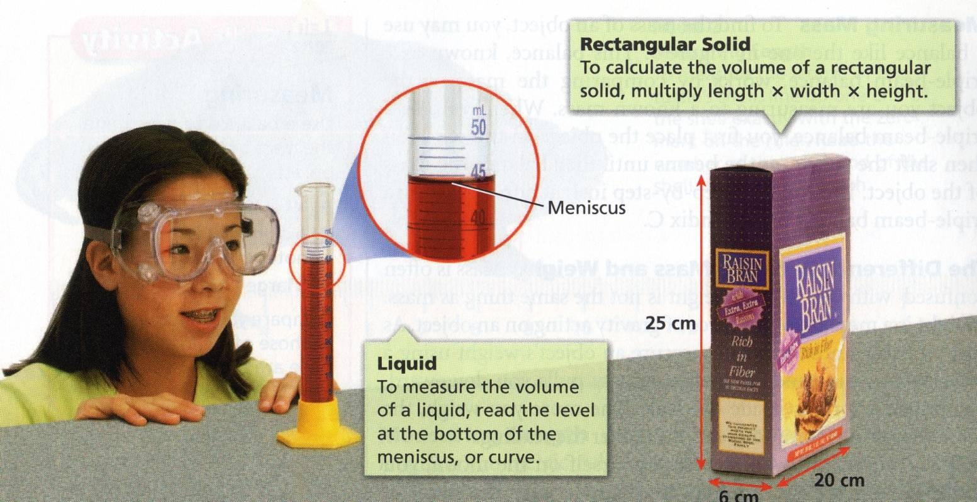
Volume of Regular Solids
L * W * H
25cm * 6cm * 20cm
= 3000
cm³
Cm³ = 1mL
1 Cubic Centimeter Equals 1 Milliliter

Slide 17
Volume of Liquids

Slide 18
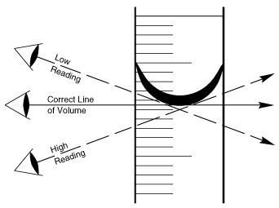
Reading a Meniscus

Slide 19
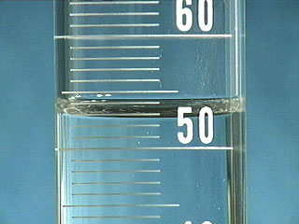

Slide 20
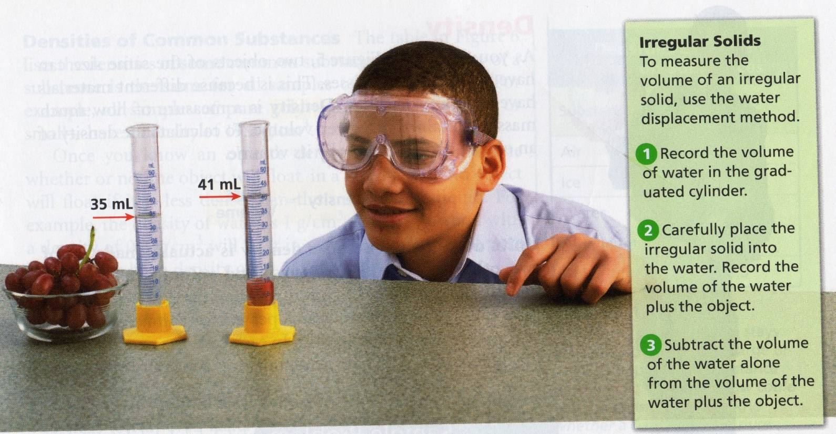
Volume of Irregular Solids

Slide 21
Mass and Weight
In The Metric System

Slide 22
Mass
A measure of the amount of matter an object contains
The basic unit of mass in the Metric (SI) system is the KILOGRAM(Kg)
Everything has mass
  Solids
  Liquids
  gases

Slide 23
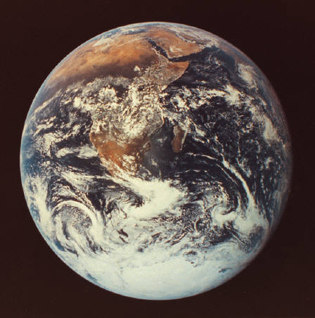
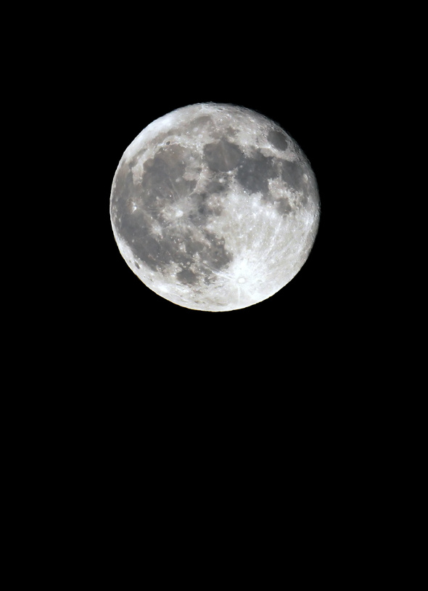
Mass and Weight
WEIGHT is the force of gravity acting on an object—how hard gravity pulls the object down
Weight is often confused with mass but they measure different things
  MASS does not change with location—your mass is the same on Earth or the moon
  Weight changes with location—you weigh less on the moon than on Earth

Slide 24
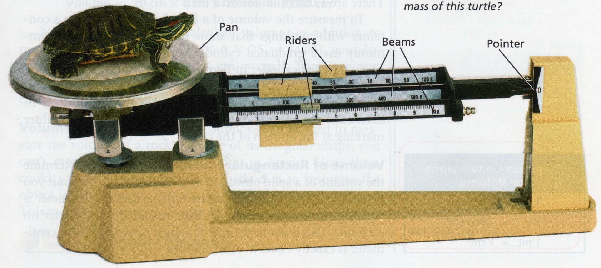
Triple Beam Balance

Slide 25

Triple Beam Balance
Make sure the balance is “zeroed out”
Always place the object in the CENTER of the pan
Move the BIGGEST rider first, one notch at a time until the pointer sinks below zero. Move the rider back one notch
Move the NEXT BIGGEST rider, one notch at a time until the pointer sinks below zero. Move the rider back one notch
Move the SMALLEST rider one notch at a time until the pointer balances at zero
Add up the amounts shown on the riders to find the mass of the object

Slide 26
Zeroing out
Our triple beam balances are hard to zero out
What you can try instead:
  Start with all the riders set in their grooves at zero
  With nothing in the pan, move the smallest rider one notch at a time until the pointer is at zero
  Record this number. It is your correction factor
  Conduct your measurements
  Subtract the correction factor from each measurement to get an accurate reading

Slide 27
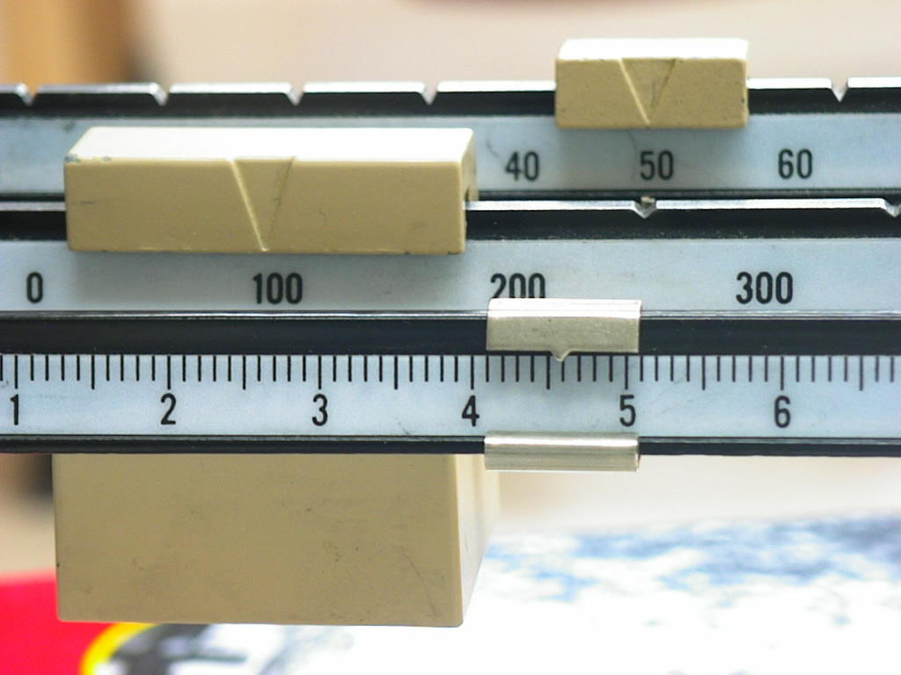
100g
+ 50g
+ 4g
+ 0.6g
154.6 g

Slide 28
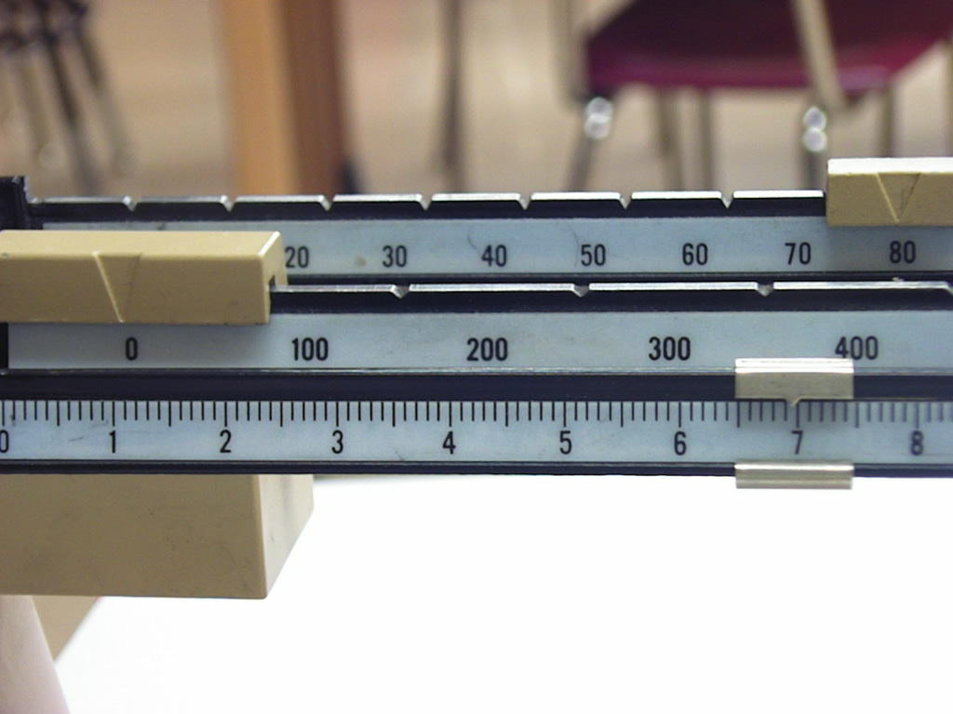

Slide 29
Density, Time & Temperature
In The Metric System

Slide 30
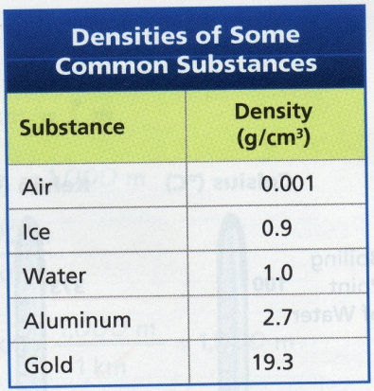
Density
How much mass is contained in a given volume
Density is LOVE
  Density equals mass divided by volume (D=m/V)
Because density is not measured directly, but calculated, the units are a combination of the units used in the calculation (g/mL or g/cm³)

Slide 31
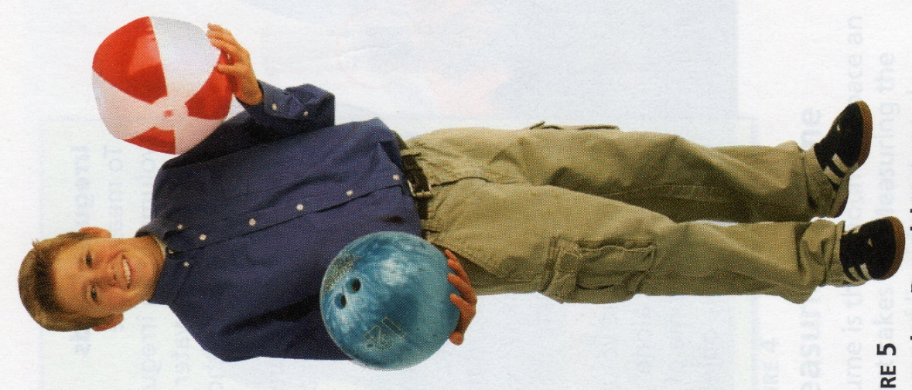
Comparing Densities
A bowling ball and a beach ball have about the same volume
Which has the greater MASS?
Which has the greater DENSITY?

Slide 32
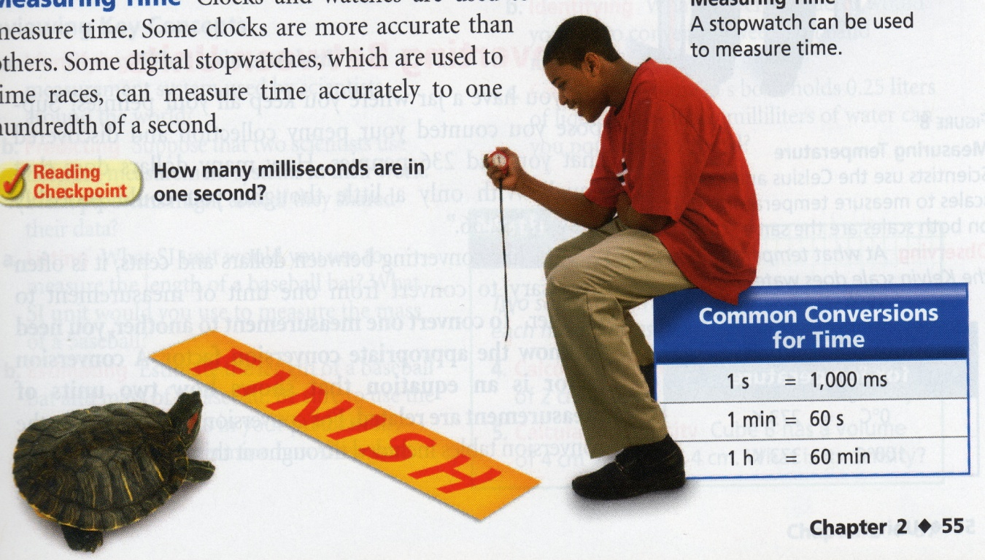
Time
The basic unit of time in the Metric (SI) system is the SECOND (s)
Just like in the English system

Slide 33
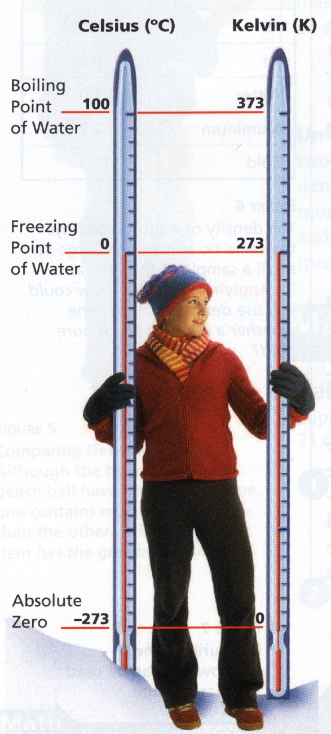
Temperature
A measure of the average motion of the particles in a substance
In the Metric (SI) system temperature is measured in degrees KELVIN (K) but degrees CELCIUS (ºC) is also acceptable
The Kelvin scale does not have negative numbers but the Celsius scale does
0 K = -273 ºC

Slide 34
Temperature Conversions
To convert from Fahrenheit to Celsius:
To convert from Celsius to Fahrenheit:
To convert from Kelvin to Celsius :
To convert from Celsius to Kelvin:
ºC = (ºF - 32) * 5/9
ºF = (ºC * 9/5) + 32
ºC = K - 273
K= ºC + 273

