Slide 1
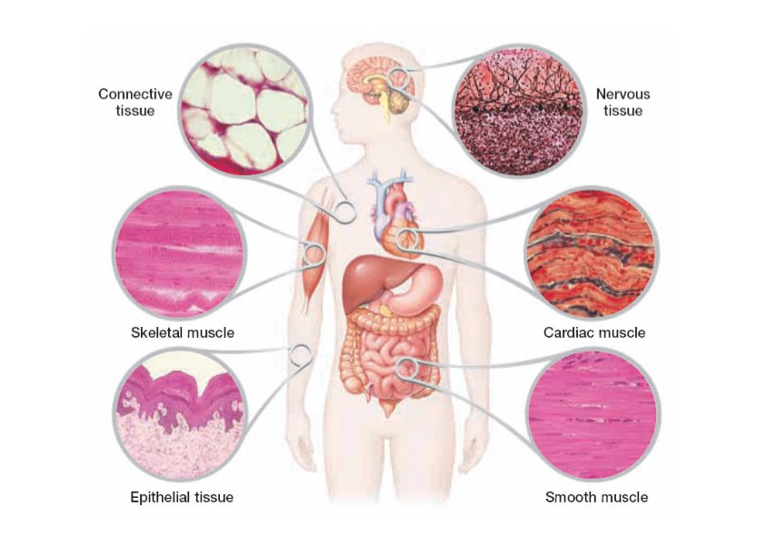
Human Body Tissues

Slide 2
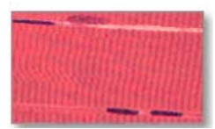
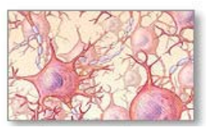
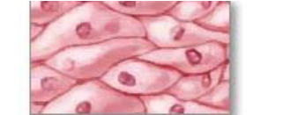
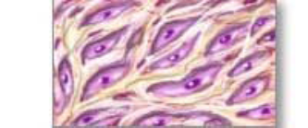
Body Tissues
The human body has 4 main types of tissues:
Muscle tissue
Nervous tissue
Epithelial tissue
Connective tissue

Slide 3
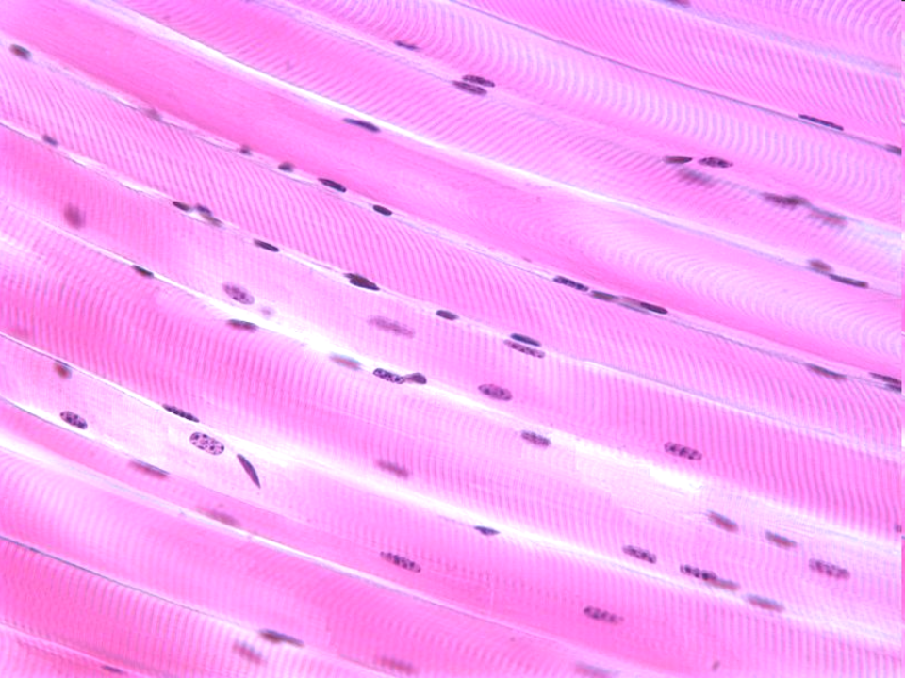
Muscle Tissue
Composed of cells that can contract.
Three types:
1. Skeletal – moves the bones in your trunk, limbs, and face.
2. Smooth – handles body functions that you cannot control consciously (food in digestive track)
3. Cardiac – in your heart. Pumps blood through your body

Slide 4
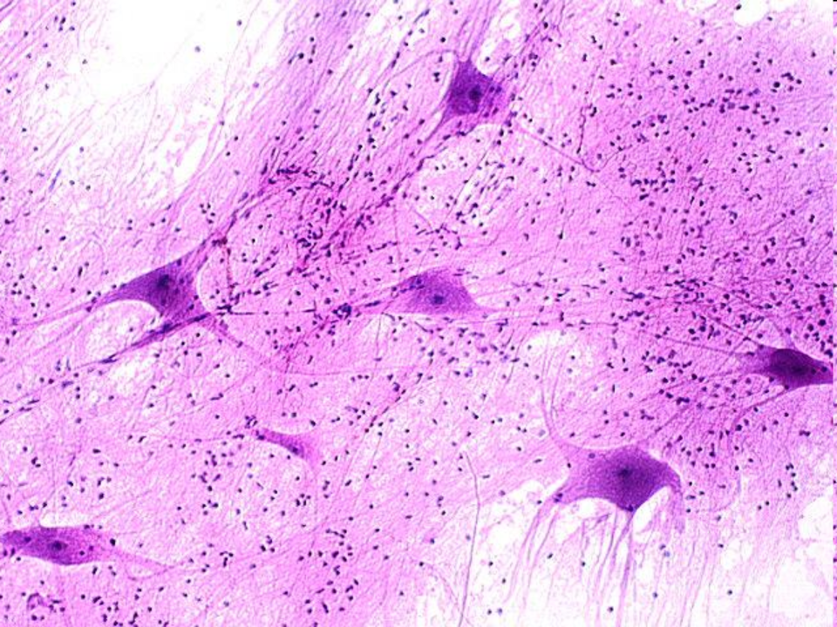
Nervous Tissue
Groups of cells that receive and transmit messages in form of electrical impulses
The cells are called neurons!

Slide 5
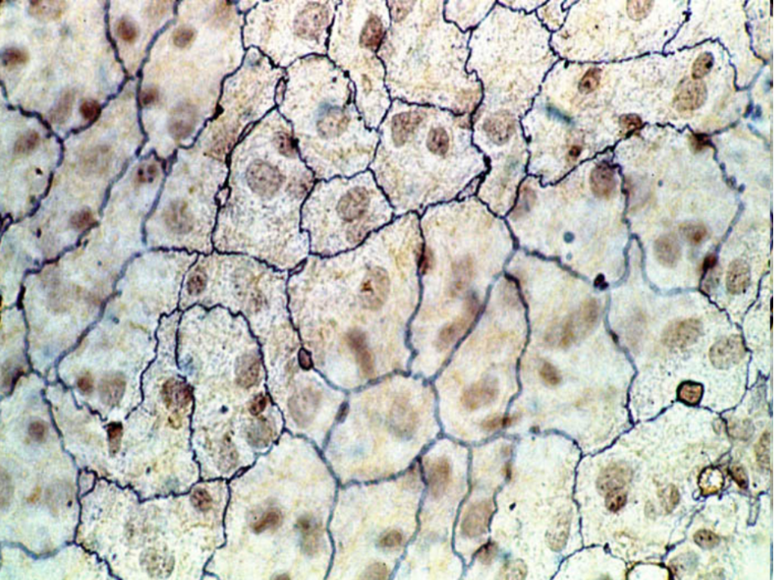
Epithelial Tissue
Consists of layers of cells that line or cover all internal and external body surfaces.
Protective barrier
Skin, stomach lining, intestinal lining

Slide 6
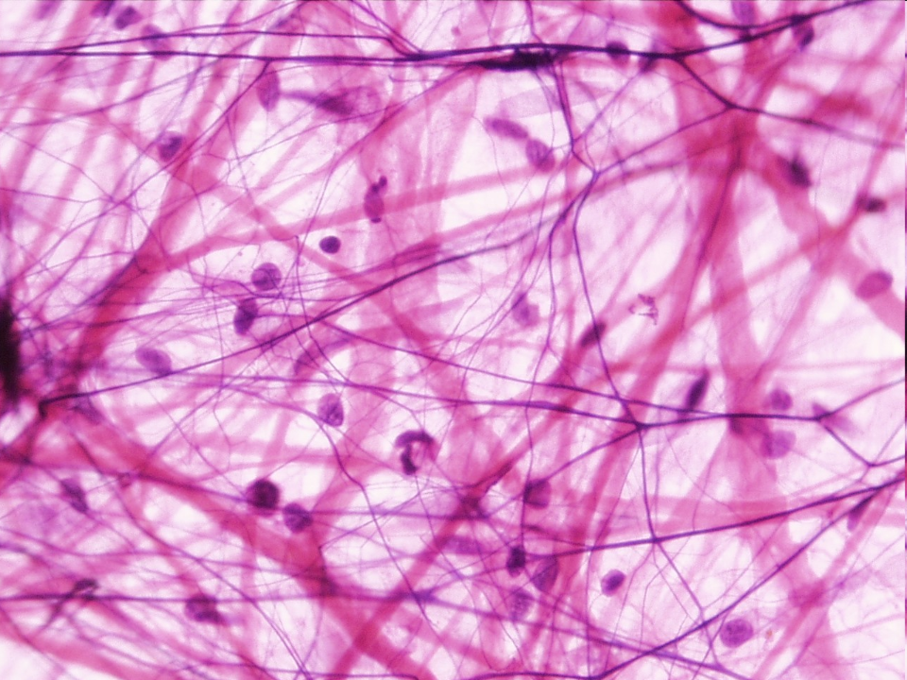
Connective Tissue
Binds, supports, and protects structures in the body
Most abundant and diverse
Includes bones, cartilage, tendons, fat, blood, and lymph.

