Slide 1
Bell Ringer 3/31/16
Please grab your science notebook and label a new page “Earth’s Interior”.
Please grab the notes from my desk.
We will be doing notes and TAPING them in there.

Slide 2
Earth’s Interior

Slide 3
Exploring inside Earth
Scientist use 2 main types of evidence to learn about Earth’s interior
    Direct evidence from Rock Samples
    Indirect evidence from Seismic Waves

Slide 4
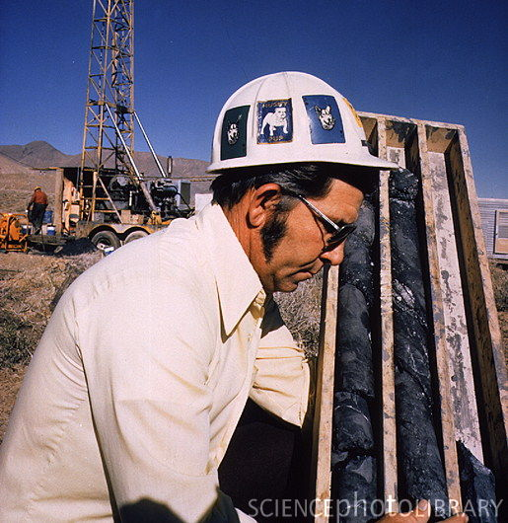
Rock Samples
Geologist have drilled holes up to 12 kilometers (almost 7.5 miles) deep and collected rock samples.
Sometimes rocks are blasted to the surface from deep inside the Earth.

Slide 5
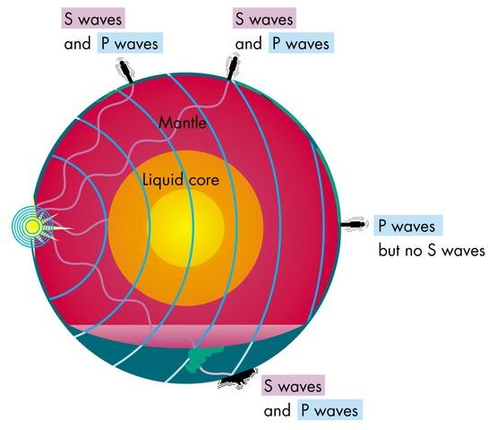
Seismic Waves
Earthquakes produce seismic waves.
Seismic waves travel differently through different layers of the Earth.
Seismic wave data is used to understand:
    State
    Material
    Temperature

Slide 6
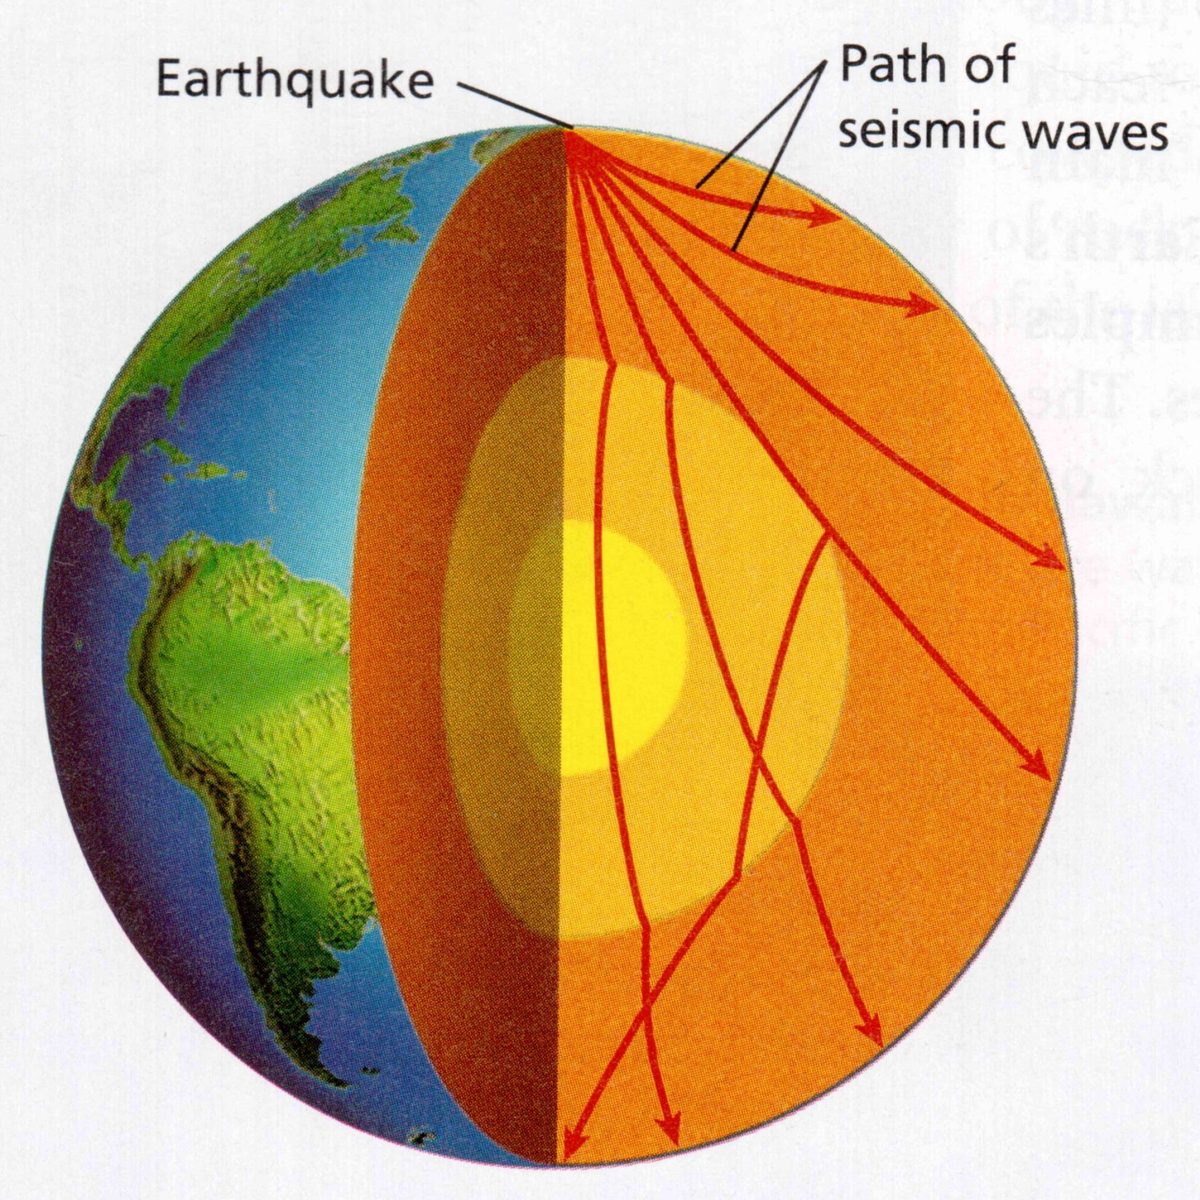

Slide 7
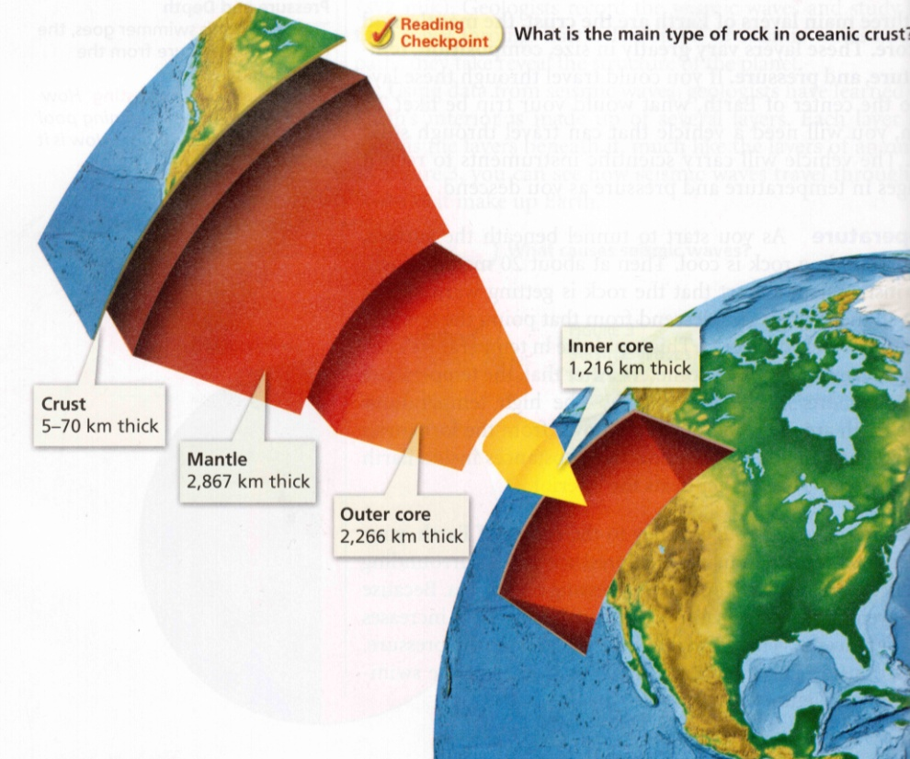
A Journey to the Center of the Earth
The 3 main layers of the Earth are the CRUST, the MANTLE and the CORE. These layers vary greatly in size, composition, temperature and pressure

Slide 8
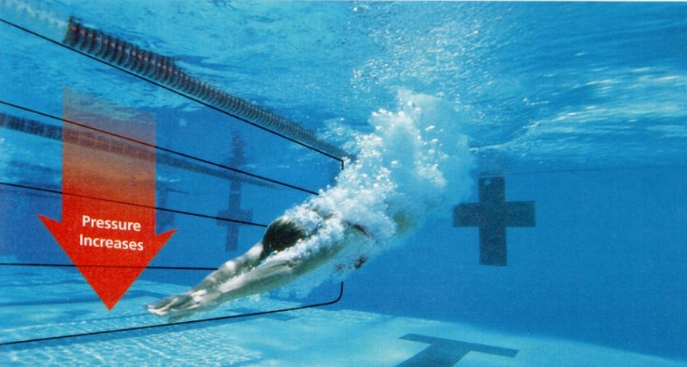
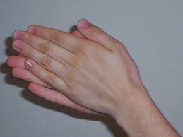
Temperature, Pressure and Density
As you move from the surface of the Earth to the center, temperature, pressure and density increases.
The weight of the rock above increases pressure. Increased pressure increases temperature.

Slide 9
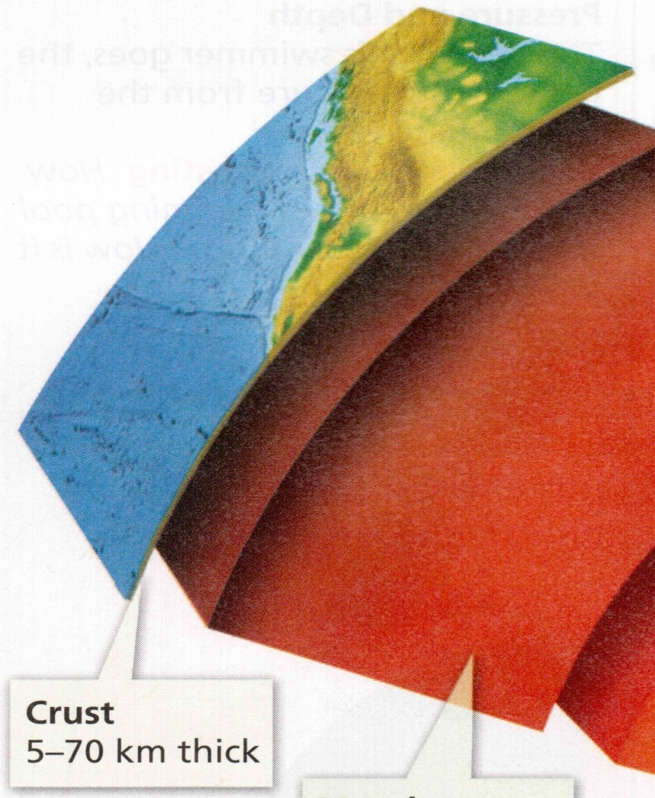
The Crust
The crust is the outermost layer of solid rock that includes both dry land and the ocean floor
Between 5 and 70 kilometers thick
Least dense layer (Silicon and Oxygen compounds)

Slide 10
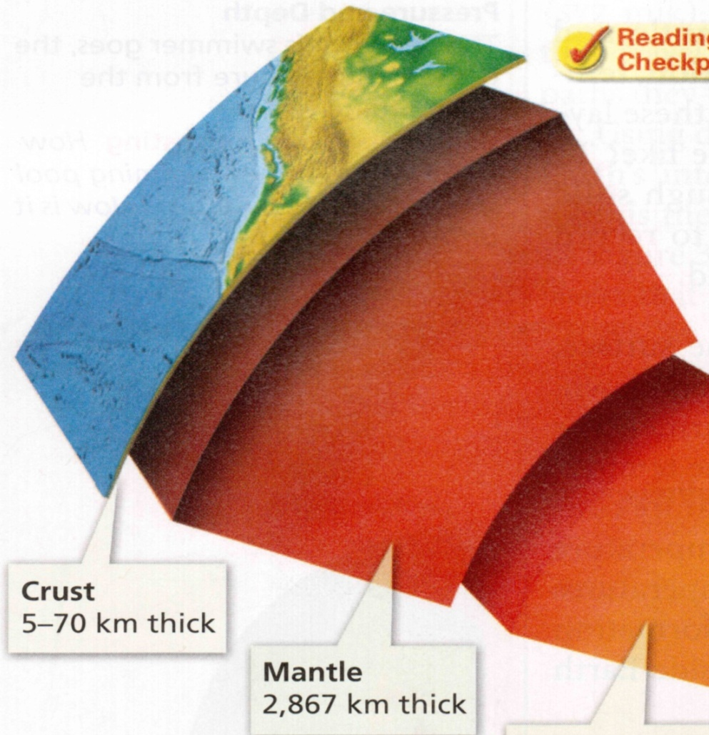
The Mantle
The mantle is made up of rock that is very hot, but solid (plastic).
The mantle is in the middle of the density layers (Aluminum and Calcium compounds)
Divided into 2 parts
  Lithosphere and Asthenosphere
About 3000 kilometers thick

Slide 11
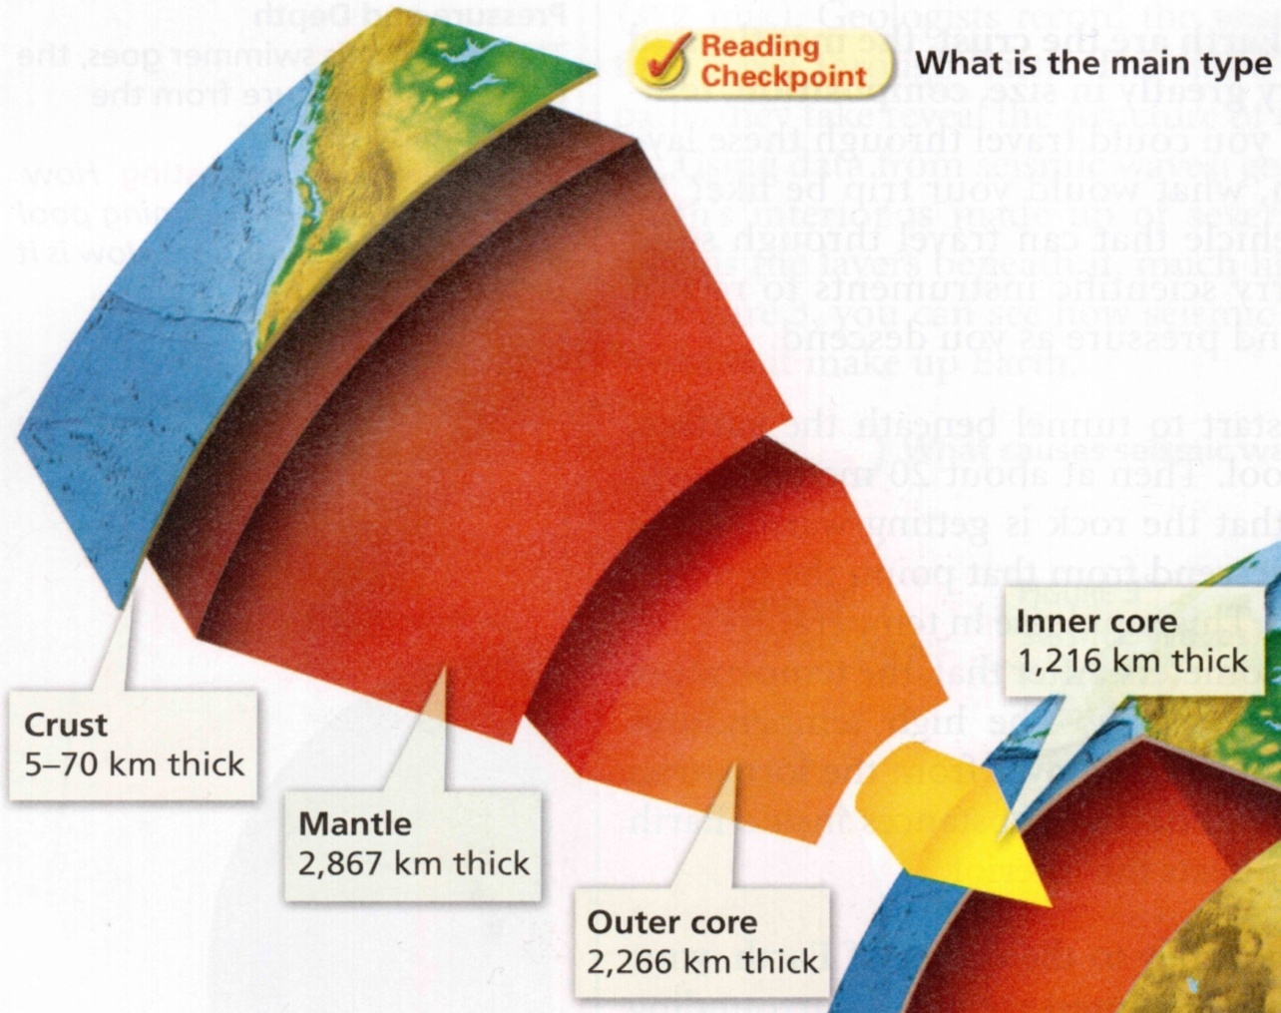
The Core
The core is the layer at the center of the Earth.
About 3500 kilometers thick
Divided into 2 parts
  Solid Inner Core and Liquid Outer Core
Most Dense layer (Iron and Nickel )

Slide 12
