Slide 1
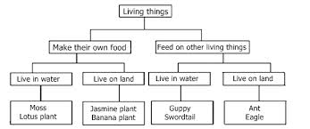
9/29 Science- Please update Science Notebook. Warm up: What are the characteristics of the Lotus plant?

Slide 2
Lotus plant

Slide 3
Create your own ‘Dichotomous Web’ for the following objects:
Scissors
Pencil
Sharpie
Highlighter
Dry Erase Marker
Ruler

Slide 4
Make your own classification web (tree)!
Shoe Classification Web:
Directions: Mrs. Myres will divide you into groups. In your group, please take off your left shoe and put in your group’s shoe pile. Sort the shoes according to their characteristics. Create a web or a ‘Dichotomous Web’ to identify each shoe! Everyone’s name should be on the web at some point. There should only be one shoe in each category when you are done.

