Slide 1
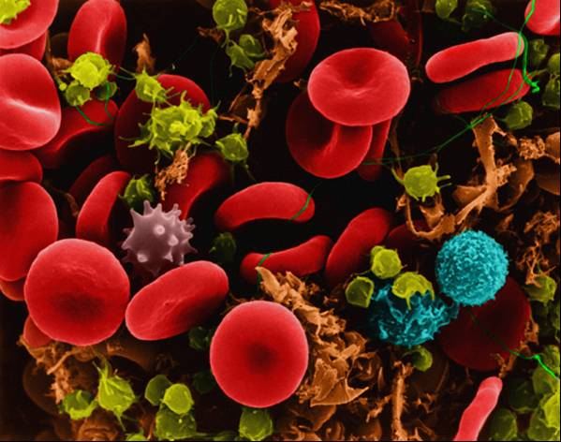
Cell Transport

Slide 2
What is a cell membrane?
The cell membrane (also known as the plasma membrane or cytoplasmic membrane) is a biological membrane that separates the interior of all cells from the outside environment.

Slide 3
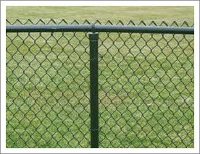
How does the cell membrane do its job?
The cell membrane is selectively permeable.
-This means it allows only certain things to pass through
Many things we use today are selectively permeable
Strainer
Chain link fence
Screen door

Slide 4
There are two types of cell transport
Passive transport- the movement of dissolved materials through a cell membrane without using cellular energy.
Active transport- the movement of materials through a cell membrane using cellular energy.
Active transport requires the cell to use its own energy, while passive transport does NOT.

Slide 5
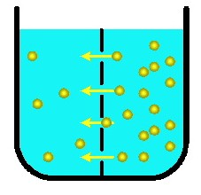
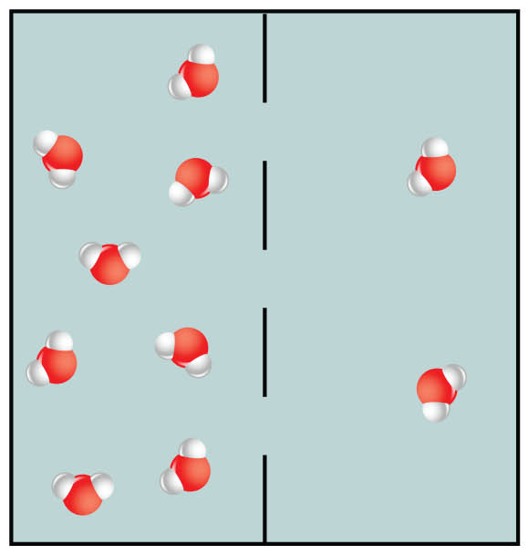
Passive Transport (Brain Pop)
Diffusion-The process by which molecules move from an area of higher concentration to an area of lower concentration.
Osmosis-Diffusion of water molecules through a selectively permeable membrane (still high concentration to low)

Slide 6
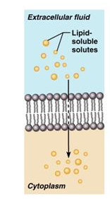
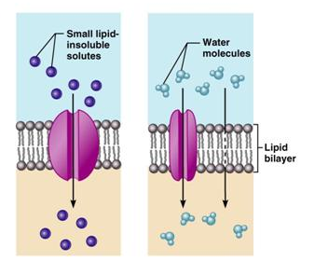
How passive transport works
Osmosis and Diffusion Animation Video
Molecules wander into the cell
If something is too big, it won’t get in.
This is how the membrane “controls” what gets in and out

Slide 7
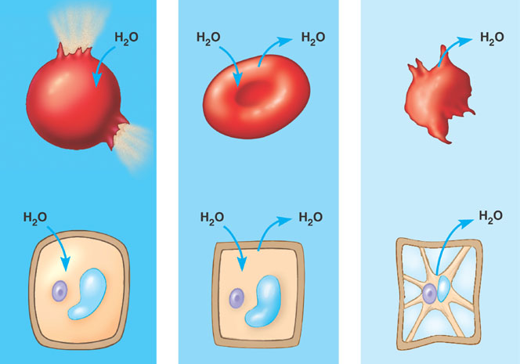
Effects of Osmosis
Amount of water affects the shape of the cell:
-Higher water concentration = cells expand
-Equal water = cells normal
-Lower water concentration = cells shrink

Slide 8
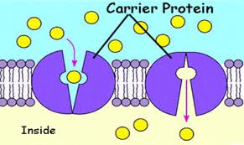
Active Transport (Brain Pop)
Active transport-Using energy to move particles from low concentration to higher concentration.
Method: Transport by engulfing

