Slide 1
Cell Theory Section A1.1
The cell is the basic unit of living things…

Slide 2
Living things are different from nonliving things…
You are surrounded by life, but how would you define a living thing?
Does it use energy?
Does it move?
Does it consume food and water?
Organism- any individual form of life that uses energy to carry out its activities.

Slide 3
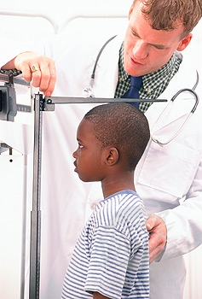
Characteristics of Living Things ….(a review)
All living things:
are made up of cells (organization).
respond to the environment.
have the ability to reproduce.
Made of DNA
grow and develop.
perform metabolic processes.
Metabolism- the sum of the physical and chemical processes in an organism

Slide 4
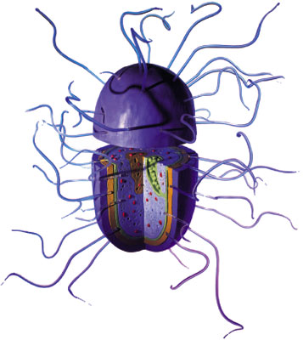
Organization…
An organism’s body must be organized in that enables it to meet its needs.
Some organisms are simple:
Bacteria
Archaea
Most Protists
Some organisms are more complex:
When different parts of the organism performs different functions.
Examples: Humans, dogs, fish, mushrooms, oak trees

Slide 5
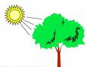
Needs for life…
Organisms need energy, materials, and living space.
All energy comes from the sun.
Some organisms use
this energy directly
(photosynthesis)
Others harness this
energy by eating food
Materials needed:
Carbon dioxide, oxygen, nitrogen, water

Slide 6
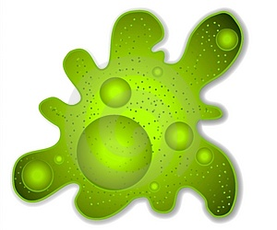
All living things are made up of cells….
The cell is the smallest unit of a living thing.
If an organism is unicellular,
all functions of life happen
within that one cell.
If an organism is multicellular,
different cells have different jobs and they all work together.

Slide 7
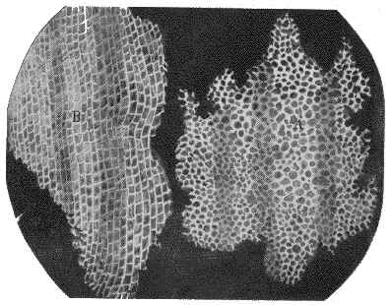
The microscope led to the discovery of cells.
1660’s – Robert Hooke discovered the cell
He looked at cork under the microscope (30x)
He noticed little compartments, which he named after the little rooms that monks lived in…”Cells”
1670’s – Anton von Leeuwenhoek described microorganisms in pond water
He looked at pond water under the microscope (300x)
He noticed that the water was full of moving living things

Slide 8
Cell Theory…
With the invention of the microscope and the contributions of many scientists, a very important question was answered in the 1850’s. The question was:
Where do cells come from?

Slide 9
There are three concepts to the cell theory…
All living things are composed of cells.
Cells carry out the basic structures and functions needed to support life.
All cells are produced from other cells.

Slide 10
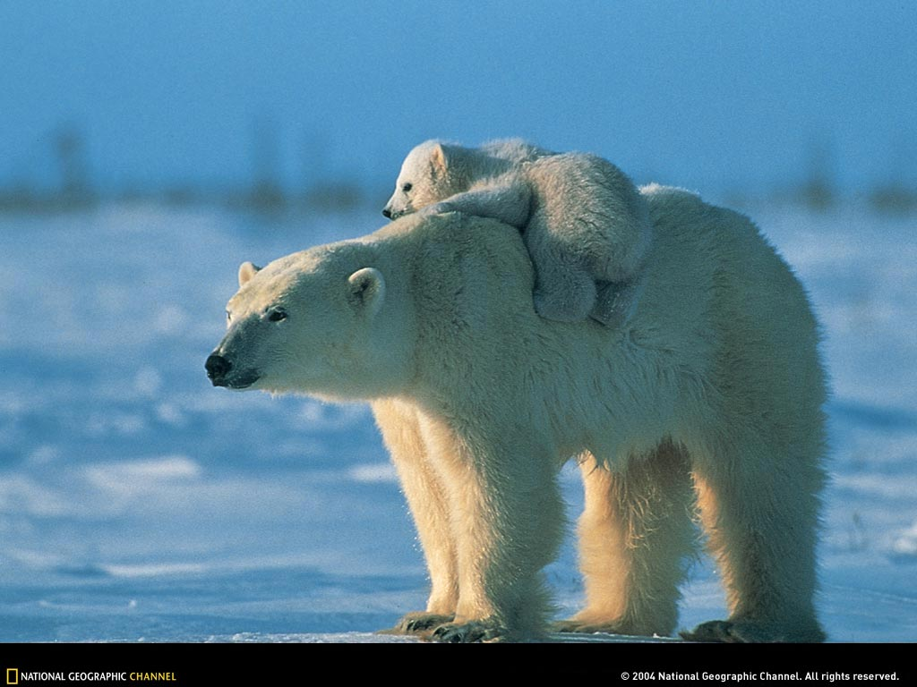
Concept #3- All polar bears cell came from a single living cell. They divide and they grow to replace old dead cells!
Concept #1- A polar bear is made up of many cells!
Concept #2- Different cells in a polar bears body does different jobs. Example: Fat cells provide insulation and energy, while red blood cells carry oxygen.

