Slide 1
Body Organization and Homeostasis

Slide 2
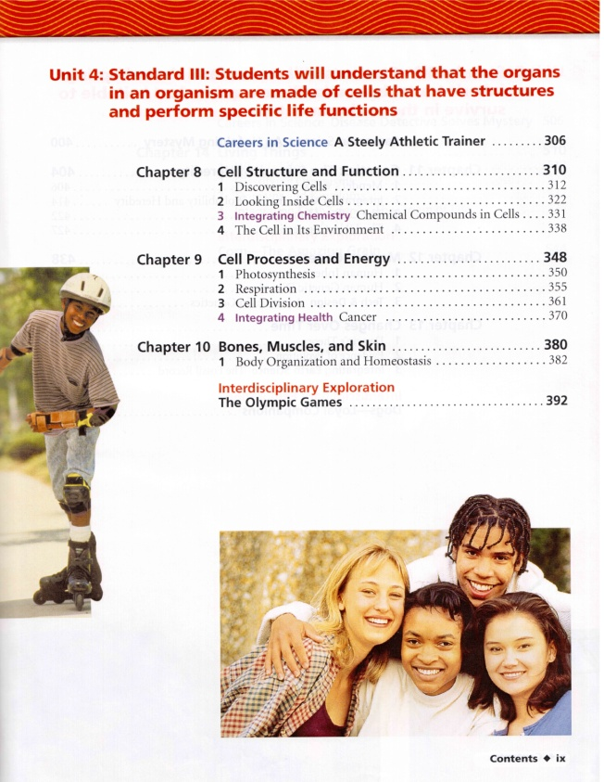
How is a text book organized?
Examine the textbook on your lab table.
How is it divided and subdivided?

Slide 3
How is a TEXT BOOK organized?
How is a LIVING THING organized?
Whole Book
Organism
Unit
Organ System
Unit
Organ System
Chapter
Organ
Chapter
Organ
Chapter
Organ
Chapter
Organ
Section
Tissue
Section
Tissue
Section
Tissue
Section
Tissue
Section
Tissue
Section
Tissue
Section
Tissue
Section
Tissue
Sub
Section.
Cell
Sub
Section
Cell
Sub
Section
Cell
Sub
Section
Cell
Sub
Section.
Cell
Sub
Section
Cell
Sub
Section.
Cell
Sub
Section.
Cell
Sub
Section.
Cell
Sub
Section.
Cell
Sub
Section.
Cell
Sub
Section.
Cell
Sub
Section.
Cell
Sub
Section.
Cell
Sub
Section.
Cell
Sub
Section.
Cell

Slide 4
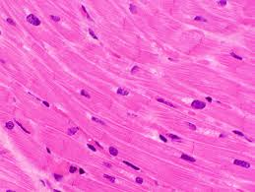
Cells
Are the basic unit of structure and function in a living thing
Cells in a body are like bricks in a building
Heart cells

Slide 5
Tissues
A group of similar cells that perform the same function.
The human body contains four types of tissue:
Epithelial
Muscle
Connective
Nervous

Slide 6
Muscle Tissue

Slide 7
Nervous Tissue

Slide 8
Connective Tissue

Slide 9
Epithelial Tissue

Slide 10
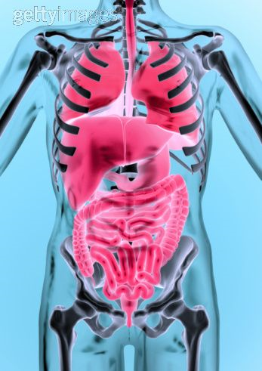
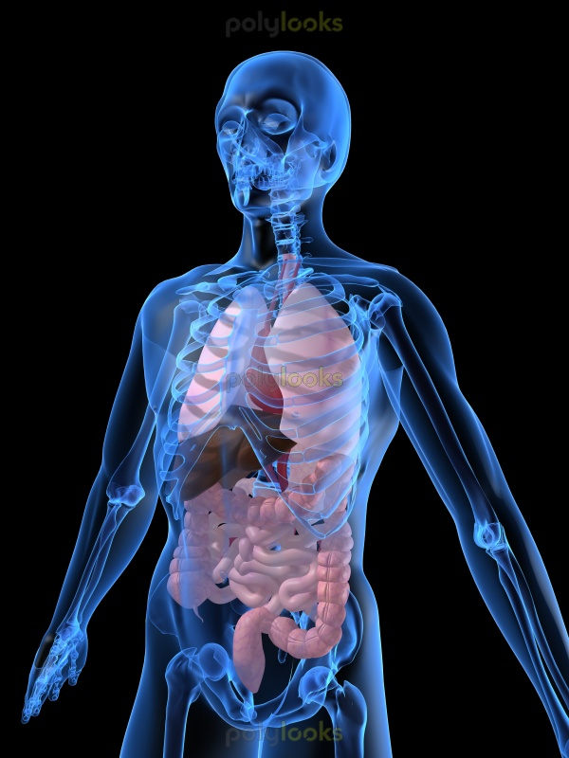
Organs
A structure composed of different kinds of tissue that performs a specific job.

Slide 11
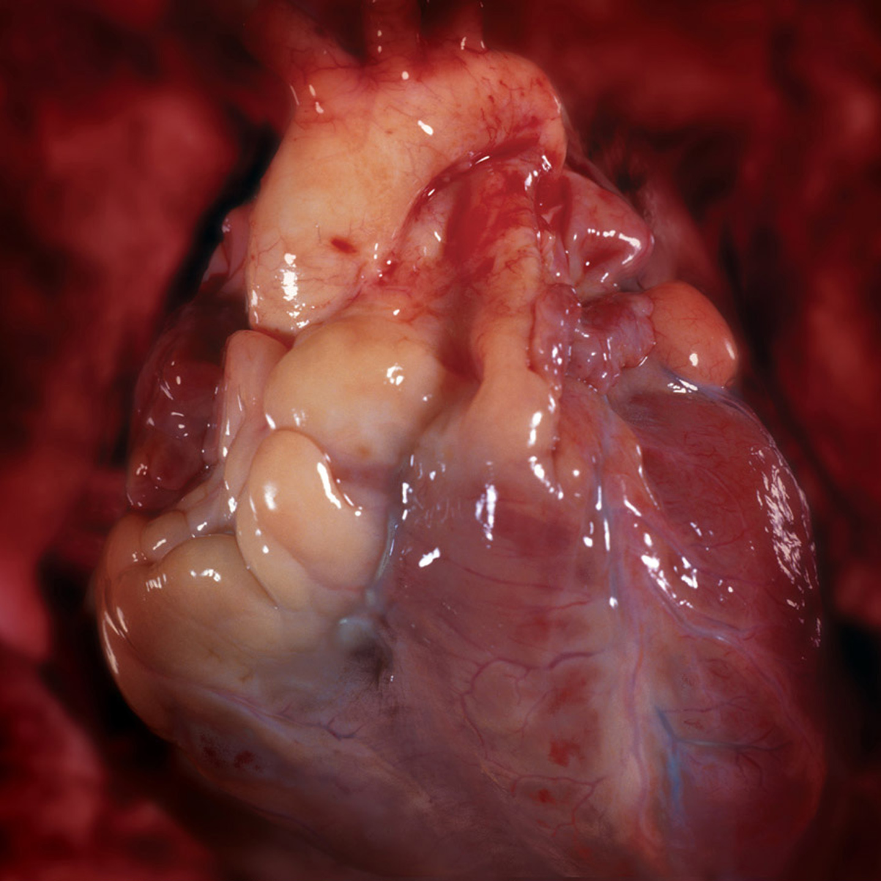
Connective Tissue
Muscle Tissue
Nerve Tissue

Slide 12
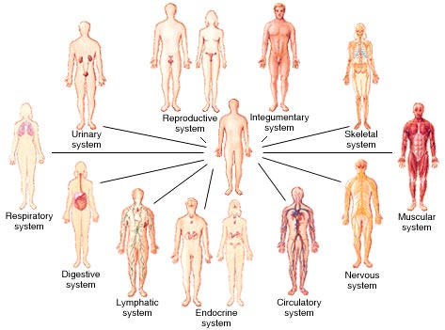
Organ Systems
A group of organs that work together to perform a major function.
The human body has 11 organ systems.

Slide 14
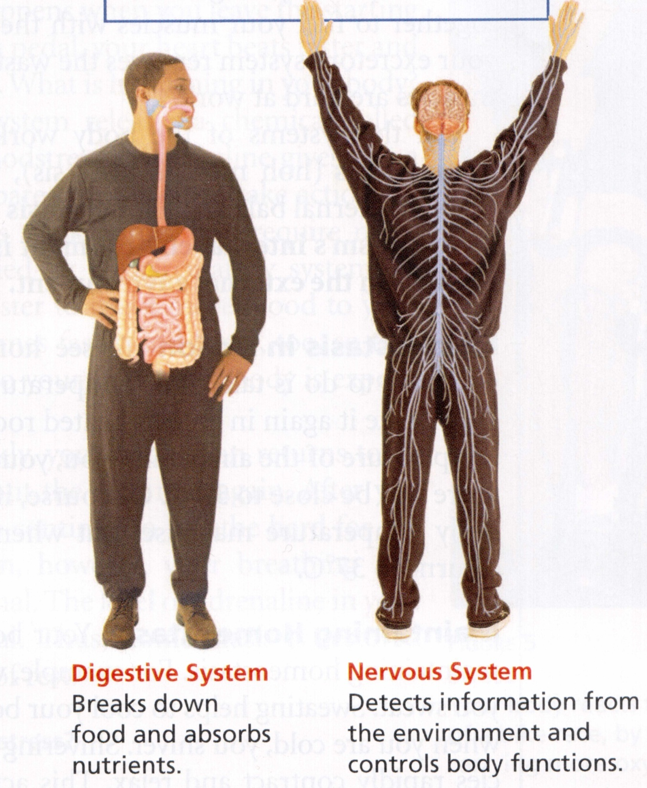

Slide 15
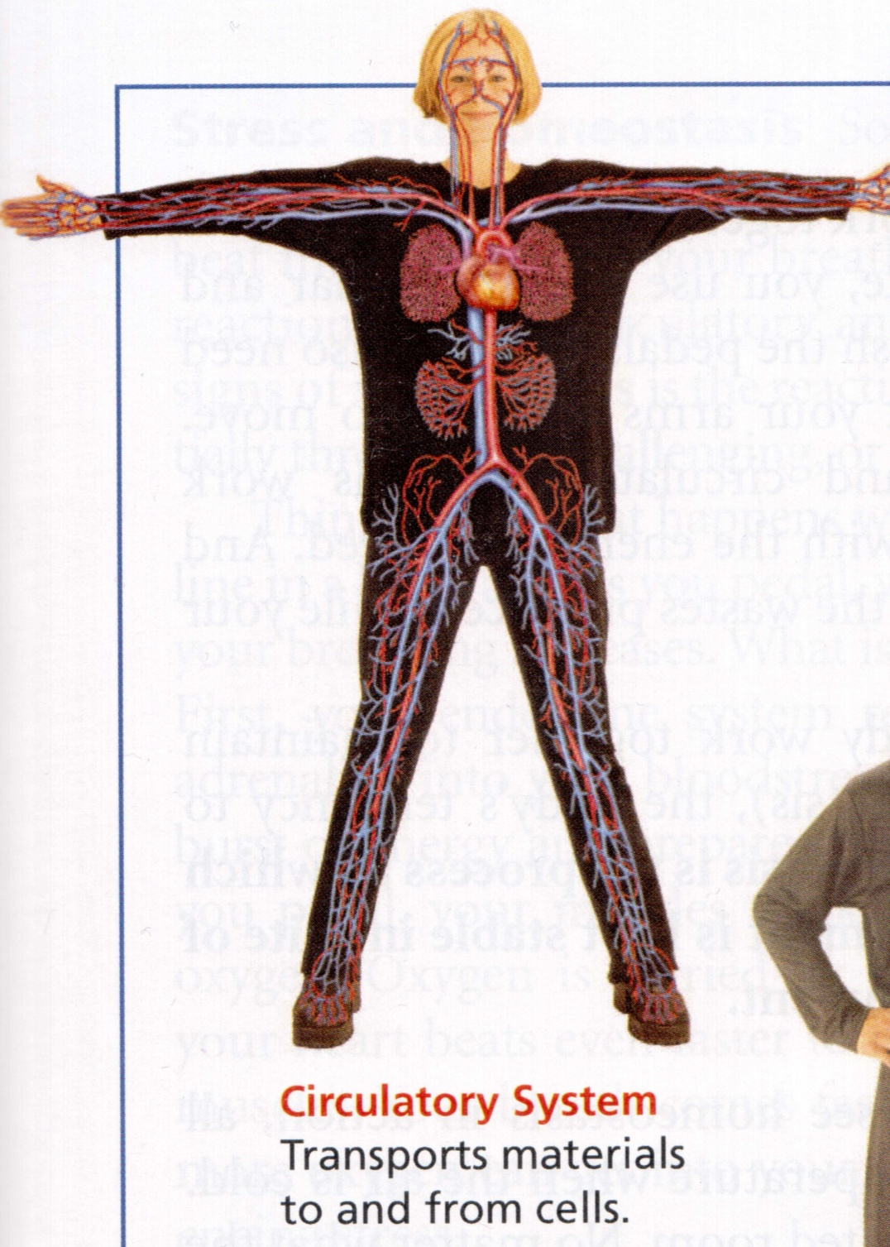
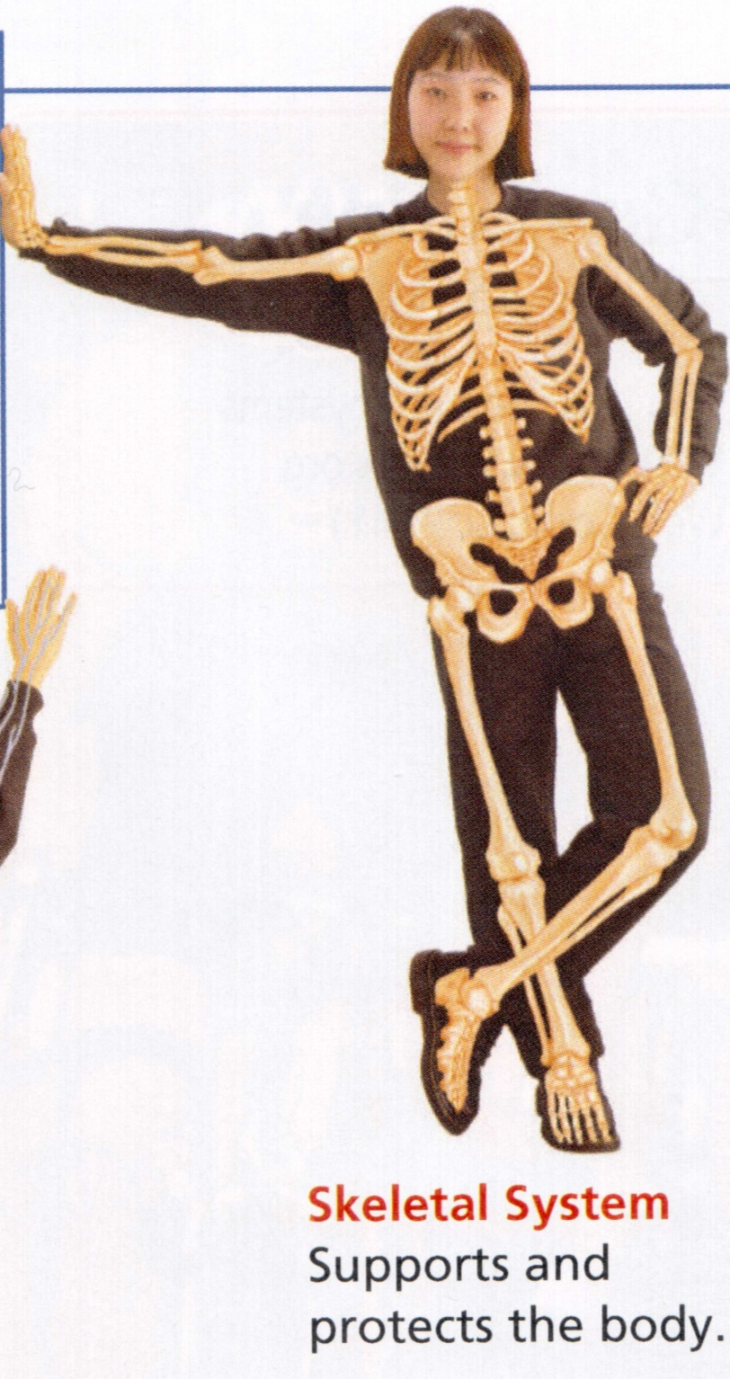

Slide 16
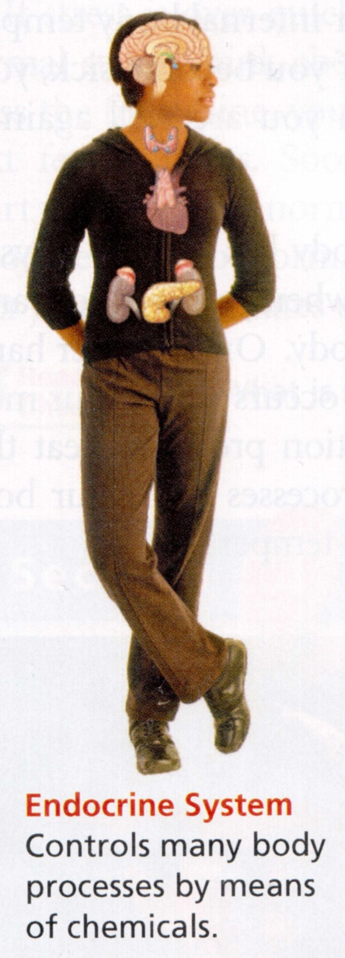
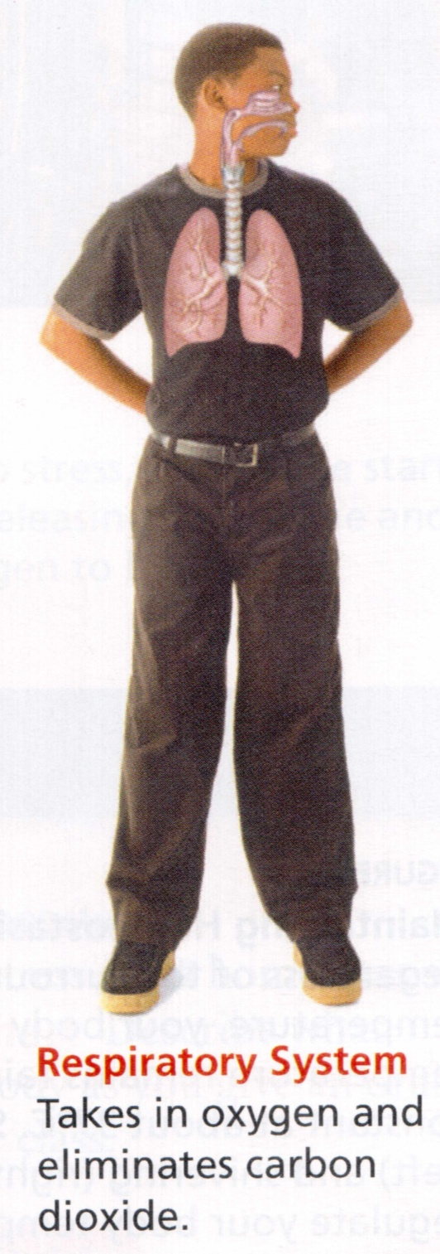

Slide 17
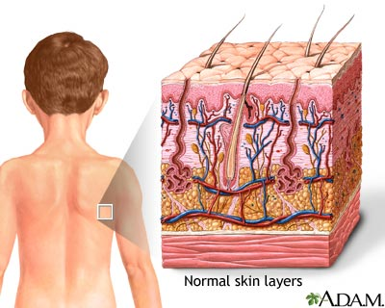
Integumenatery System
Is associated with the skin and the glands under it. This system helps keep the body temperature stable.

Slide 18
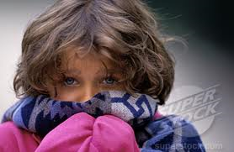
Homeostasis
The process by which an organism’s internal environment is kept stable in spite of changes in the external environment
You sweat when its hot…
You shiver when its cold.

